Slide 1
Session 01
(Wallace)
*respect copryright law — use this PowerPoint only for the purposes of this course, do not duplicate or distribute

Slide 2
Orientation / Schedule
Last saved: 9/29/2013
Notes:
Today process, poets, key concepts
Note web page, handout also available there, ask about workshop
process
session 1 lecture
session 2 process, request of poem coverage
basho poems
session 3 narrow road
session 4 return to basho, explore on karumi
then buson perhaps
session 5 buson
session 6 Issa Workshop
draw to any poem
will bring some images (actual haiga, and other evocative images to work directly on)
will post these after class, with chance to comment
Will focus on these writers: (next slide)

Slide 3
Three Edo period haiku masters
Matsuo Bashō 松尾芭蕉 (1644-94)
Traveled widely, most activity in Edo
Yosa Buson 与謝蕪村 (1716-84)
Traveled widely, most activity in Edo, then Kyoto
Kobayashi Issa 小林一茶 (1763-1828)
Traveled widely, most activity in his home town in Nagano prefecture
Notes:
Notice the time spread, note Genroku period, Japan a closed but peaceful country

Slide 4
Matsuo Bashō — early poems
1. Danrin-style poems
foolishly, in the dark,
he grabs a thorn:
hunting fireflies
gu ni kuraku ibara wo tsukamu hotaru kana
愚に暗く棘を掴む蛍かな
Notes:
Three periods
(Barnhill #55 “darkness” “ignorance”) 165

Slide 5
Matsuo Bashō — late poems
2. Sabi さび
Thoughts on a journey this autumn:
why do I feel so old?
into the clouds, a bird
kono aki wa nande toshiyoru kumo ni tori
この秋はなんで年寄る雲に鳥

Slide 6
Matsuo Bashō — very late poems
3. Karumi / karomi
in the scent of plums
suddenly the sun peeps out—
the mountain path
Umegaka ni notto hi no deru yamaji kana
梅が香にのつと日の出る山路哉
Notes:
Ueda

Slide 7
Yosa Buson
According to Masaoka Shiki (1867–1902) —
“Haikai history had two high points … and the best poet of each is Bashō and Buson. … [in his Haiku Poet Buson, 1897] Buson emerges as the opposite of everything Shiki found characteristic of Bashō. Where Bashō wrote negative (消極的), colorless, and highly subjective poetry, Buson’s was positive (積極的), vigorous, and objective. Bashō was a poet of autumn and winter, Buson of spring and summer.”
(Cheryl Crowley, Haiku Poet Yosa Buson and the Basho Revival, 2007)

Slide 8
Yosa Buson
Because Buson is so well known for his painting, perhaps at his time even more than for his haiku, it isn’t surprising that later he has been interpreted and presented as deeply visual in his approach.
mustard flowers
with the moon in the east
the sun in the west
菜の花や月は東に日派に西
nanohanaya tsukiha higashini hiha nishini
Notes:
Go to next slide now, for color then this slide will return to this
Ueda 180

Slide 9
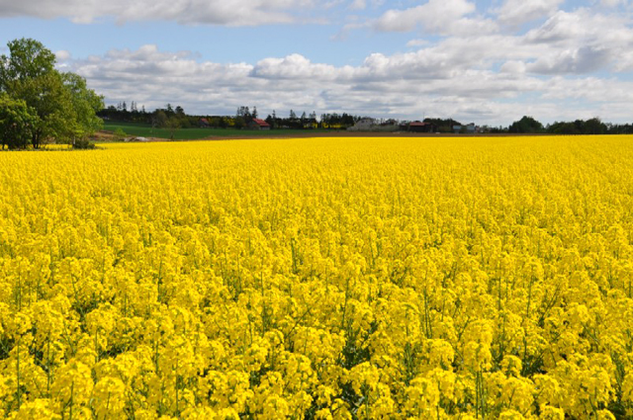
Mustard flower / Nanohana 菜の花
Notes:
Ueda 180, next is form discussion

Slide 10
Yosa Buson
But in addition to his “visual” poems …
Excellent form
Poems that tell stories
Poems with a gothic edge to them, among other things
As for form …
mustard flowers
with the moon in the east
the sun in the west
菜の花や月は東に日は西に
Nanohana ya tsuki ha higashi ni hi ha nishi ni
Notes:
Ueda 180
How colorful is proven on the next page

Slide 11
Matsuo Bashō / Yosa Buson
Regarding the “Bashō is subjective / Buson is objective” binary:
Bashō’s death poem
Ill on a journey:
My dreams roam round
Over withered fields
Buson’s death poem
from now on
every night will dawn
with white plum blossoms
Notes:
Barnhill for Basho, Ueda Thorns 133 for Buson
Tabi ni yande yme ha kareno o kakemeguru
shiraume ni akuru yo bakari to narinikeru

Slide 12
Kobayashi Issa
His popular reception is as the “cute and charming” poet who wrote such poems in the face of much personal tragedy
corner spider rest easy, my soot-broom is idle
sumi no kumo anjina susu ha toranu zo yo
隅の蜘案じな煤はとらぬぞよ
Notes:
1765 : Age 3 : Issa’s mother (Kuni) dies
• 1776 : Age 14: Issa’s grandmother (Kana) dies
• 1777: Age 15: Issa moves to Edo (Tokyo) in the springtime.1814 : Age 52: married his first wife (Kikuko - who was 28 years old)
• 1816 : Age 54: Issa’s first son, Sentaro is born, but dies soon afterward
• 1818 : Age 56: First daughter, Sato is born, but she dies the following year.
• 1820 : Age 58: Second son, Ishitaro is born. He dies the following year.
• 1822 : Age 60: Third son, Kinsaburo in born. He too dies the next year.
• 1823 : Age 61: Issa’s first wife, Kikuko dies at age 37.
• 1824 : Age 62: marries Yuki, who is 38 years old but they soon divorce.
• 1826 : Age 64: Issa marries for the third time to Yawo. She is 32 years old at the time.
• 1827 : Age 65: Issa’s home catches fire and burns down in the Kashiwara Fire.
The family temporarily moves into a storehouse that remained standing after the fire.
November 19 : Issa passes away while living in the storehouse.

Slide 13
Kobayashi Issa
However, some of his best poems definitely have a raw pain in them and to skip these is to miss a great deal of his expressive successes:
mother and children separated, separated — hunted birds
oya to ko to wakare wakare ya oware tori
親と子と別れ別れや追れ鳥

Slide 14
Three key points for interpreting haiku / haiga:
Evocativeness / Yojō / 余情
Notes:
Three key things for this class needed to appreciate haiku which are difficult to appreciate

Slide 15
Three key points for interpreting haiku / haiga: “Linking”
… nioi [fragrance] poetics favored a more metaphorical juxtaposition in which the maeku [preceding verse] and the tsukeku [the verse to follow it] intersected on a shared connotation . . . Bashō’s ideal link by scent . . . was based on analogies that were distant, that is to say not readily apparent and non-conventional, but that once made, were all the more striking, novel, or compelling.
(Haruo Shirane)

Slide 16
“Linking”, cont.
Maeku—
Rice plants in their growing season
feeble in the feeble wind
(Hamade Chinseki)
Tsukeku—
Starting a new life
as a monk, he travels
through the Suzuka Pass.
(Matsuo Bashō)
Notes:
Ine no hanobi no / chikara naki kaze
いねのはのびの力なき風 珍碩
Hosshin no / hajime ni koyuru / Suzukayama
発心のはじめにこゆるすずか山 芭蕉

Slide 17
Three key points for interpreting haiku / haiga: Lightness / karumi / かるみ
Written in the moment
Written casually, simply
Severe reduction or elimination of subjective perspective (Zen influence)
“the essence of haiku was to use ordinary language to go beyond the ordinary” / ““the point of the haiku is to perceive, understand and express the beauty of the seemingly commonplace”
Steven Addiss
We will return to this later.
Notes:
“just make tea”
HAIku

Slide 18
Haiku (俳句)
Haiku evolved from linked-verse. It was called hokku or haikai. It wasn’t called haiku until much later.
Linked-verse (renga 連歌)
“Initial verse” (hokku 発句)
Haikai (haikai 俳諧) playful; witty; jocular
Haiku (=HAIkai KU [verse])
Notes:
HAIku

Slide 19
Haiga (俳画)
Haiga is a painting with a haiku written on it.
It therefore originates with haiku (hokku).
It has a large number of influences: Zen painting (禅画), Chinese / Japanese nanga (南画), Kano school, etc.
Nonoguchi Ryūho (野々口立圃, 1595–1669) was one of the first.
Notes:
HAIku

Slide 20
Haiga (俳画)
The word haiga did not come into use until the Tenpō period [1830-44]. Buson did not use this word himself; he referred to his haikai pictures as '"haikai rough sketches" はいかいの草画.
The first use of "haiga" is attributed to Watanabe Kazan 渡辺華山 (1793-1841).
Notes:
HAIku

Slide 21
Haiga (俳画)
Watanabe Kazan on haiga:
Haiga is that which takes aesthetic refinement (風流, fūryū) as its first principle.
Making everything too perfect is not good; to a certain extent paint badly.
To put it in human terms as an example, being clever and shrewd in one's behavior or a good talker is bad; knowing little of the world and stuttering naiveté is seen as aesthetic refinement (fūryū) and one should try to achieve this and introduce it into one's work.
With morning glories, the clumsier you paint them, the more pathos they have.
Notes:
HAIku

Slide 22
Haiga (俳画)
What of our poets?
Matsuo Bashō painted quite a few haiga and also added gravitas to them.
Yosa Buson is probably considered the preeminent premodern master of the tradition.
Kobayashi Issa is less skilled, perhaps.
Notes:
HAIku

Slide 23
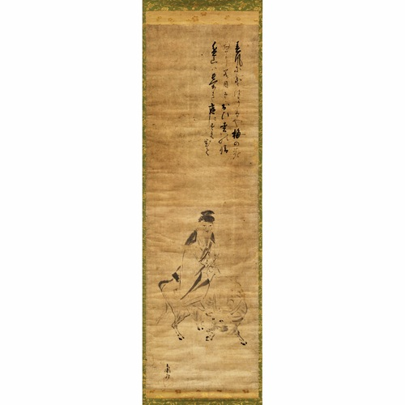
Nonoguchi Ryūho (1595–1669)
野々口立圃
Notes:
Early, not yet haiga style, simple relationship between poem and picture
A wealthy merchant from Kyōto, he was a disciple of the haikai master Matsunaga Teitoku but later broke with the Teitoku school.

Slide 24
Nonoguchi Ryūho (1595–1669)
野々口立圃
Notes:
春風に
乗（り）うつり香や
梅の花
たにま（に）目立（つ）
おひ松の情
遥（な）山は
忘なき
庭にすえおく
（菅原道真像）
立圃拝[落款（松翁）] 』 紙面89×27.4糎 幅面174×29.5糎 箱入
野々口立圃（文禄四1595～寛文九1669）：江戸前期の俳人。松永貞徳門の代表的俳人で、家業は人形屋で通称雛屋ともいう。著作多数、書・画もよくした。
http://gyokueido.jimbou.net/catalog/kn_product_info.php/products_id/34566?osCsid=08b79c2bc07efc0684548c0088e3c5ce

Slide 25
Nonoguchi Ryūho (1595–1669)
野々口立圃
Notes:
Here he is on his oxen
春風に
乗（り）うつり香や
梅の花
たにま（に）目立（つ）
おひ松の情
遥（な）山は
忘なき
庭にすえおく
（菅原道真像）
立圃拝[落款（松翁）] 』 紙面89×27.4糎 幅面174×29.5糎 箱入
野々口立圃（文禄四1595～寛文九1669）：江戸前期の俳人。松永貞徳門の代表的俳人で、家業は人形屋で通称雛屋ともいう。著作多数、書・画もよくした。
http://gyokueido.jimbou.net/catalog/kn_product_info.php/products_id/34566?osCsid=08b79c2bc07efc0684548c0088e3c5ce

Slide 26
Nonoguchi Ryūho (1595–1669)
野々口立圃
Notes:
Review of relationship
春風に
乗（り）うつり香や
梅の花
たにま（に）目立（つ）
おひ松の情
遥（な）山は
忘なき
庭にすえおく
（菅原道真像）
立圃拝[落款（松翁）] 』 紙面89×27.4糎 幅面174×29.5糎 箱入
野々口立圃（文禄四1595～寛文九1669）：江戸前期の俳人。松永貞徳門の代表的俳人で、家業は人形屋で通称雛屋ともいう。著作多数、書・画もよくした。
http://gyokueido.jimbou.net/catalog/kn_product_info.php/products_id/34566?osCsid=08b79c2bc07efc0684548c0088e3c5ce

Slide 27
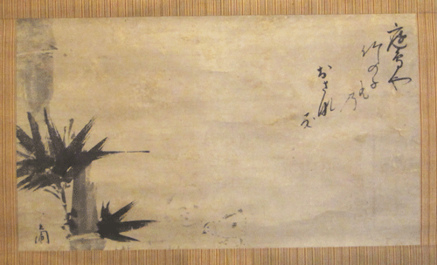
Nonoguchi Ryūho (1595–1669) — haiga
Farm chickens. The new bamboo shoots …
鶏や竹の子

Slide 28
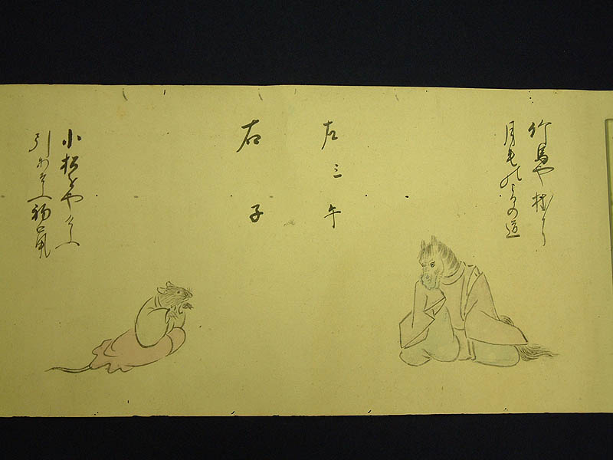
Nonoguchi Ryūho (1595–1669) — haiga
Notes:
貞門の俳人、野々口立圃(1595-1669)の自筆句合画巻。十二支の動物に装束を着せて一対ずつ左右に向かわせ、立圃自作の発句を合わせたもの。動物の組み合わせは、辰と戌、巳と亥のように、7番目同士を合わせる「七ツ目」というめでたい組み方で配列されている。最初の辰と戌の組には、辰に「夕立の水上いづこたつの口」、戌に「犬山やふるもまだらの雪の色」とある。奥書に「七十二老」とあり、寛文6年(1666)の染筆とわかる。
立圃は松江重頼と並び称された貞門の重鎮。のち貞徳のもとをはなれ一流派をひらいた。雛人形屋を業とし、若くして連歌・和歌・書を学んだ。絵は晩年の習事と伝えるが、「書画は習はずして自由自在に書ちらし」(『立圃追悼集』)とも見える。元禄以後の俳画の盛行は立圃に端を発するともいわれている。
本画巻の、淡彩をほどこした動物たちの飄々たる姿は、立圃晩年の円熟の境地を伝え、数多い立圃自筆資料のうちでも秀作ということができる。横山重旧蔵。
竹馬に／月毛の／よるの道 月毛、つきげ palomino An evening path the color of palominoes … children on stick horses
小松をや/／けふ引あそぶ／初鼠
http://www.wul.waseda.ac.jp/TENJI/virtual/juni/

Slide 29
Nonoguchi Ryūho (1595–1669) — haiga
Notes:
貞門の俳人、野々口立圃(1595-1669)の自筆句合画巻。十二支の動物に装束を着せて一対ずつ左右に向かわせ、立圃自作の発句を合わせたもの。動物の組み合わせは、辰と戌、巳と亥のように、7番目同士を合わせる「七ツ目」というめでたい組み方で配列されている。最初の辰と戌の組には、辰に「夕立の水上いづこたつの口」、戌に「犬山やふるもまだらの雪の色」とある。奥書に「七十二老」とあり、寛文6年(1666)の染筆とわかる。
立圃は松江重頼と並び称された貞門の重鎮。のち貞徳のもとをはなれ一流派をひらいた。雛人形屋を業とし、若くして連歌・和歌・書を学んだ。絵は晩年の習事と伝えるが、「書画は習はずして自由自在に書ちらし」(『立圃追悼集』)とも見える。元禄以後の俳画の盛行は立圃に端を発するともいわれている。
本画巻の、淡彩をほどこした動物たちの飄々たる姿は、立圃晩年の円熟の境地を伝え、数多い立圃自筆資料のうちでも秀作ということができる。横山重旧蔵。
竹馬に／月毛の／よるの道 月毛、つきげ palomino An evening path the color of palominoes … children on stick horses
小松をや/／けふ引あそぶ／初鼠
http://www.wul.waseda.ac.jp/TENJI/virtual/juni/

Slide 30
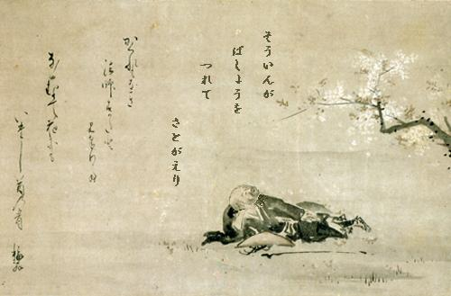
Nishiyama Sōin (verse) / Ihara Saikaku (painting)
Notes:
「花見西行図」西山宗因賛・井原西鶴画 財団法人柿衞文庫所蔵
「かくれもなき法師すがたと見奉りて ながむとて花にもいたし首の骨 梅翁」
http://www.city.yatsushiro.kumamoto.jp/museum/event/2006/2006_spring.html#

Slide 31
Nishiyama Sōin (painting) / Ihara Saikaku (verse)
Depiction of Saigyō who wrote
Notes:
「花見西行図」西山宗因賛・井原西鶴画 財団法人柿衞文庫所蔵
「かくれもなき法師すがたと見奉りて ながむとて花にもいたし首の骨 梅翁」
http://www.city.yatsushiro.kumamoto.jp/museum/event/2006/2006_spring.html#
This is what I want:
To die in the springtime,
Beneath the blossoms—
Midway through the Second Month,
When the moon is at the full. Carter, 165.
negawaku wa hana no shita nite haru shinan
sono kisaragi no mochizuki no koro

Slide 32
Nishiyama Sōin (verse) / Ihara Saikaku (painting)
whenever gazing / at flowers— / a pain in the neck too
Notes:
Translation at: http://wkdhaikutopics.blogspot.com/2007/03/nishiyama-soin.html
NOTICE THE CROOK IN THE BRANCH, THE CROOK IN THE NECK. THIS IS LINKING.「花見西行図」西山宗因賛・井原西鶴画 財団法人柿衞文庫所蔵
「かくれもなき法師すがたと見奉りて ながむとて花にもいたし首の骨 梅翁」
http://www.city.yatsushiro.kumamoto.jp/museum/event/2006/2006_spring.html#

Slide 33
Six modes of haiga according to Jim Kacian
*examples follow | Representational | Non-representational
Portraits
Iterative (poem and pic share a declared component)
Tangential (poem and pic communicate “in a glancing fashion”)
Notes:
Works Jim Kacian Simply Haiku 2:5 (Autumn 2004); reprinted in The Red Moon Anthology of English-Language Haiku, Red Moon Press, 2004, pp. 126-153.
Self portrait, Matsuo Basho
Self portrait, Inoue Shiro
Mountain (“Through the ages / rising avobe the mountains — tonight’s moon), Inoue Shiro
Minomushi We will go here last …

Slide 34
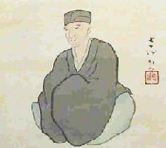
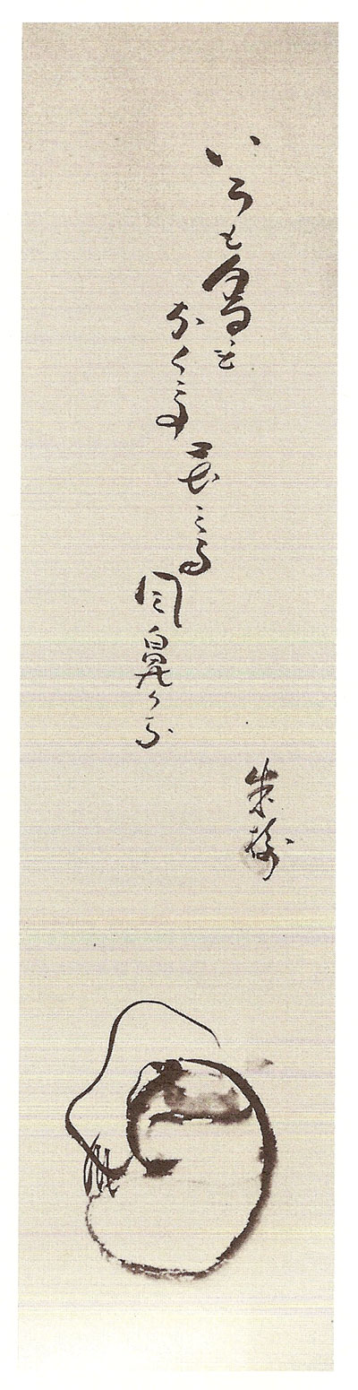
Six modes of haiga according to Jim Kacian
 | Representational | Non-representational
Portraits
Iterative (poem and pic share a declared component)
Tangential (poem and pic communicate “in a glancing fashion”)
Notes:
Works Jim Kacian Simply Haiku 2:5 (Autumn 2004); reprinted in The Red Moon Anthology of English-Language Haiku, Red Moon Press, 2004, pp. 126-153.
Self portrait, Matsuo Basho
Self portrait, Inoue Shiro
Mountain (“Through the ages / rising avobe the mountains — tonight’s moon), Inoue Shiro
Minomushi We will go here last …

Slide 35
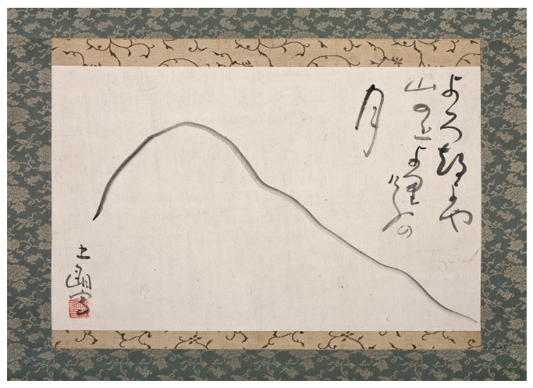
Six modes of haiga according to Jim Kacian
 | Representational | Non-representational
Portraits
Iterative (poem and pic share a declared component)
Tangential (poem and pic communicate “in a glancing fashion”)
Notes:
Works Jim Kacian Simply Haiku 2:5 (Autumn 2004); reprinted in The Red Moon Anthology of English-Language Haiku, Red Moon Press, 2004, pp. 126-153.
Self portrait, Matsuo Basho
Self portrait, Inoue Shiro
Mountain (“Through the ages / rising avobe the mountains — tonight’s moon), Inoue Shiro
Minomushi We will go here last …

Slide 36
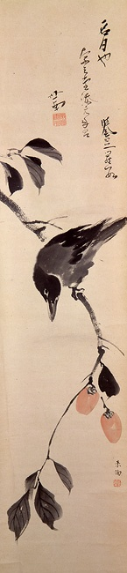

Six modes of haiga according to Jim Kacian
 | Representational | Non-representational
Portraits
Iterative (poem and pic share a declared component)
Tangential (poem and pic communicate “in a glancing fashion”)
Notes:
Works Jim Kacian Simply Haiku 2:5 (Autumn 2004); reprinted in The Red Moon Anthology of English-Language Haiku, Red Moon Press, 2004, pp. 126-153.
Self portrait, Matsuo Basho
Self portrait, Inoue Shiro
Mountain (“Through the ages / rising avobe the mountains — tonight’s moon), Inoue Shiro
Minomushi We will go here last …

Slide 37
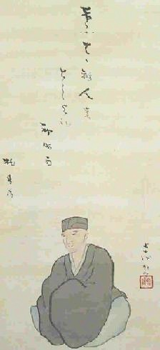
Bashō by Bashō
Just today
Lets all be old:
First winter shower.
けふはかり人も
としよれ
初時雨
Notes:
けふはかり人も
としよれ
初時雨
桃青翁
1692-93, Barnhill 617, shigure (winter)
just today, lets all be old: first winter shower

Slide 38
Six modes of haiga according to Jim Kacian
 | Representational | Non-representational
Portraits
Iterative (poem and pic share a declared component)
Tangential (poem and pic communicate “in a glancing fashion”)
Notes:
Works Jim Kacian Simply Haiku 2:5 (Autumn 2004); reprinted in The Red Moon Anthology of English-Language Haiku, Red Moon Press, 2004, pp. 126-153.
Self portrait, Matsuo Basho
Self portrait, Inoue Shiro
Mountain (“Through the ages / rising avobe the mountains — tonight’s moon), Inoue Shiro
Minomushi We will go here last …

Slide 39
Inoue Shirō (1742-1812)
No color or scent
When flower-viewing—
Stuffy nose
色も香もなくて花見る風鼻かな

Slide 40
Inoue Shirō (1742-1812)
Notes:
Addiss: Shiro was a doctor specializing in gyneocology in Nagoya. … emphasized extreme simplicity and evocative description

Slide 41
Six modes of haiga according to Jim Kacian
 | Representational | Non-representational
Portraits
Iterative (poem and pic share a declared component)
Tangential (poem and pic communicate “in a glancing fashion”)
Notes:
Works Jim Kacian Simply Haiku 2:5 (Autumn 2004); reprinted in The Red Moon Anthology of English-Language Haiku, Red Moon Press, 2004, pp. 126-153.
Self portrait, Matsuo Basho
Self portrait, Inoue Shiro
Mountain (“Through the ages / rising avobe the mountains — tonight’s moon), Inoue Shiro
Minomushi We will go here last …

Slide 42
Inoue Shirō (1742-1812)
Through the ages / rising above the mountains — / tonight’s moon
Notes:
よろず夜や
山の上より
けふの月

Slide 43
Six modes of haiga according to Jim Kacian
 | Representational | Non-representational
Portraits
Iterative (poem and pic share a declared component)
Tangential (poem and pic communicate “in a glancing fashion”)
Notes:
Works Jim Kacian Simply Haiku 2:5 (Autumn 2004); reprinted in The Red Moon Anthology of English-Language Haiku, Red Moon Press, 2004, pp. 126-153.
Self portrait, Matsuo Basho
Self portrait, Inoue Shiro
Mountain (“Through the ages / rising avobe the mountains — tonight’s moon), Inoue Shiro
Minomushi We will go here last …

Slide 44
Yamaguchi Soken (1759–1818)
The full moon!
My tears are not enough
To praise it
名月や泪添えては誉めたらず
Notes:
linking

Slide 45
Matsuo Basho (1644-94) Gate and Banana Plants
Come hear
The cry of my
Bagworms!
Rustic hut.
Notes:
Minomushi no ne o kiki ni koyo kusa no io

