Slide 1
Session 02
(Wallace)
*respect copryright law — use this PowerPoint only for the purposes of this course, do not duplicate or distribute

Slide 2
1 night . . . silently in the moonlight, a worm digs into a chestnut
Notes:
EXPLAIN (Danrin-style playfulness / word-playfulness when compared to original, use of katakana)1
夜ル竊ニ虫は月下の栗を穿ツ
yoru hisokani mushi wa gekka no kuri wo ugatsu 56
Autumn / 1680
Kigo: chestnut (kuri)
Notes: “One text has the headnote ‘The later harvest moon,’ which denotes the moon of the thirteenth night of the lunar ninth month. It was also know as “the chestnut moon” because it was the custom to offer chestnuts to the moon on this night. The hokku alludes to a line of Fu Wen’s poem, ‘the night rain silently digs into the moss on the rocks [夜ノ雨ハひそかに石上ノ苔ヲ穿ツ].’” [Ueda]
1681 This poem was written when Basho was 37.
It appeared in Azuma nikki under the title 後名月、のちのめいげつ. This is the 13th day of the 9th moon (Oct 27 this year, I think), an important moment after the 15th day of the 8th moon.
和漢朗詠集：夜ノ雨ハひそかに石上ノ苔ヲ穿ツ

Slide 3
3 on a bare branch a crow has alighted . . . autumn nightfall
Notes:
Read, then explain (vocab, kigo, kireji, syllable count): 枯枝に烏のとまりたるや秋の暮
Later version:枯枝に烏のとまりけり秋の暮 (still 字余り but one less so)
Note that he has moved to Fukugawa
3
kareeda ni karasu no tomarikeri [also, tomaritaru] aki no kure
Autumn / 1681
Kigo: autumn evening (aki no kure)
Note: “There survive three paintings on which Bashō wrote this hokku. The one assumed to be the earliest depicts seven crows settled on a leafless tree, with twenty others flying in the sky. The other two painting show only one crow perching on a branch of a bare tree.” [Ueda]

Slide 4
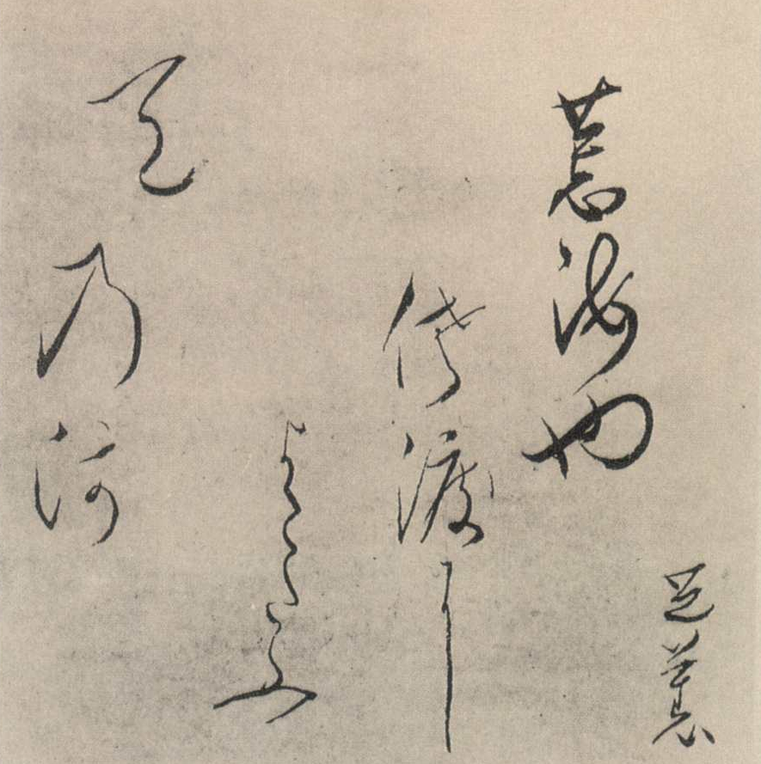
3 on a bare branch a crow has alighted . . . autumn nightfall
Calligraphy by Bashō
Notes:
As example of kireji emphasis

Slide 5
In a tree that stands on the crag by abandoned paddies, a dove calling to its companion in the desolate twilight
Saigyō (1118–90), Sankashū no. 997
Notes:
READ INTERPRETERS 57, SANKASHU (Tosai was born 1750)
--Burton Watson, Poems from a Mountain Home, 154
古畑（ふるはた）のそばの立つ木にいる鳩（はと）の友（とも）呼ぶ声のすごき夕暮れ
3
枯枝に烏のとまりたるや秋の暮
kareeda ni karasu no tomarikeri [also, tomaritaru] aki no kure
Autumn / 1681
Kigo: autumn evening (aki no kure)
Note: “There survive three paintings on which Bashō wrote this hokku. The one assumed to be the earliest depicts seven crows settled on a leafless tree, with twenty others flying in the sky. The other two painting show only one crow perching on a branch of a bare tree.” [Ueda]

Slide 6
evening crow— in a bare tree on the mountain peak a voice
Hie 冷え “chill” yase 痩せ “gauntness”
Notes:
READ FROM: Interpreters 60 (Ueda)
夕烏峯の枯木に声はして
3
枯枝に烏のとまりたるや秋の暮
kareeda ni karasu no tomarikeri [also, tomaritaru] aki no kure
Autumn / 1681
Kigo: autumn evening (aki no kure)
Note: “There survive three paintings on which Bashō wrote this hokku. The one assumed to be the earliest depicts seven crows settled on a leafless tree, with twenty others flying in the sky. The other two painting show only one crow perching on a branch of a bare tree.” [Ueda]

Slide 7
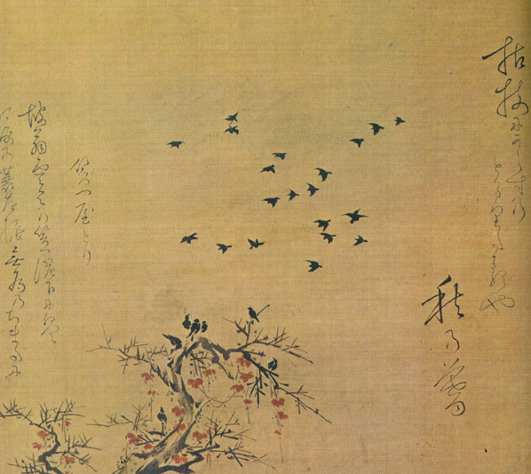
3 on a bare branch a crow has alighted . . . autumn nightfall
Painting, calligraphy, poem by Bashō
Notes:
枯枝に烏のとまりたるや秋の暮
The poem does not grammatically determine the number of birds
Image from: http://taka.no.coocan.jp/a5/cgi-bin/dfrontpage/kaigatohaiku/basyounado2.htm (http://taka.no.coocan.jp/a5/cgi-bin/dfrontpage/)

Slide 8
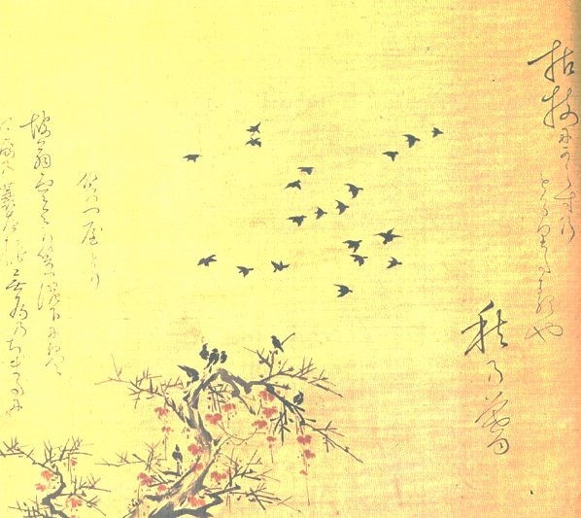
3 on a bare branch a crow has alighted . . . autumn nightfall
Notes:
枯枝に烏のとまりたるや秋の暮
A focus just on composition shows this image to emphasize tomaritaru — “to alight” / “to be in the process of alighting”
Notice BTW how far to the edge the poem is

Slide 9
3 on a bare branch a crow has alighted . . . autumn nightfall
Notes:
枯枝に烏のとまりたるや秋の暮
Although there is considerable interest in the birds that have already perched.
Note that the witheredness of the branch is emphasized by adding something like mistletoe berries (The title of the painting is:枯枝からす笠やどり自画賛)
If we move to a later version …

Slide 10
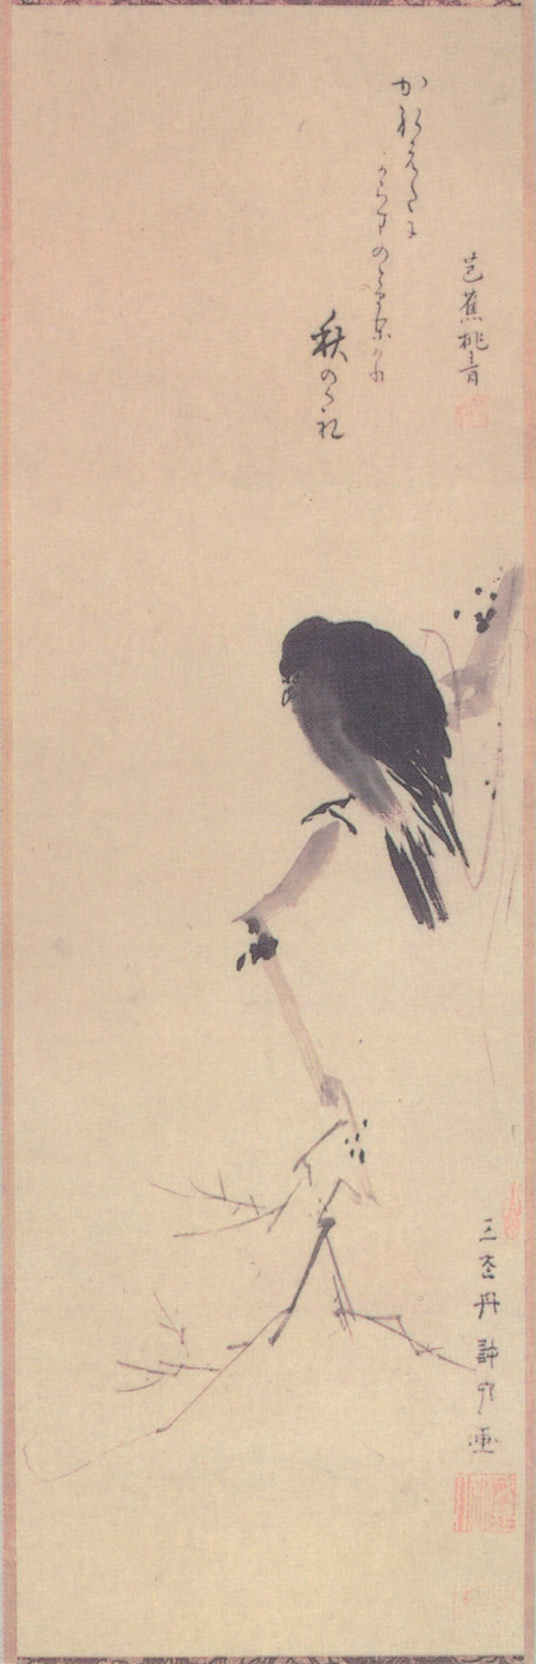
3 on a bare branch a crow has alighted . . . autumn nightfall
Painting by Kyoriku, calligraphy and poem by Bashō
Notes:
枯枝に烏のとまりけり秋の暮 (still 字余り but one less so)
Image at: http://commons.wikimedia.org/wiki/File:Morikawa_Kyoriku_%26_Matsuo_Basho_-_kareeda_ni.jpg
This is a later version. Although the poem is from 1681, the painting is probably 1691 or 92.
Definitely more sabi, emptier / more simple / yojo very strong, poem more prominent in its position

Slide 11
3 on a bare branch a crow has alighted . . . autumn nightfall
Notes:
枯枝に烏のとまりけり秋の暮 (still 字余り but one less so)
Distinctly withered, showing sabi
And whereas we have “the community” of crows in the earlier painting, here we have a solitary crow with a different mood

Slide 12
3 on a bare branch a crow has alighted . . . autumn nightfall
Notes:
枯枝に烏のとまりたるや秋の暮
Although there is considerable interest in the birds that have already perched.
Note that this is not an entirely withered branch.
If we move to a later version …

Slide 13
3 on a bare branch a crow has alighted . . . autumn nightfall
Notes:
枯枝に烏のとまりけり秋の暮 (still 字余り but one less so)
Image at: http://commons.wikimedia.org/wiki/File:Morikawa_Kyoriku_%26_Matsuo_Basho_-_kareeda_ni.jpg
This is a later version. Although the poem is from 1681, the painting is probably 1691 or 92.

Slide 14
4 one who breakfasts with morning glories: that’s what I am
Notes:
EXPLAIN poem (kireji, kudaketa vocabulary) 朝顔に我は飯食う男哉
asagao ni ware wa meshi kū otoko kana
READ, Interpreters 81
4
Autumn / 1682
Kigo: morning glory (asago)
Notes: “The poem Bashō referred to in the headnote was based on the proverb ‘Some worms eat nettles’: ‘within the grassy gate / a firefly eats nettles / —that is what I am kusa no to ni ware wa tade kū hotaru kana.’” [Ueda] Takarai Kikaku (1661–1707) was one of Bashō’s disciples.

Slide 15
5 the crescent moon— a bud on the morning glory swelling at night
Notes:
Link comment a) thin-but-swelling-to-roundness moon, thin-but-swelling-to-roundness Asagao; b) shape c) two objects to love
5*
三ケ月や朝顔の夕べ蕾むらん
mikazuki ya asagao no yūbe tsubomu ran
Autumn / 1682
Kigo: crescent moon (mikazuki)

Slide 16
6
I buy water at this grass-thatched hut. ice, tasting bitter in the mouth of a sewer rat, quenches his thirst
Notes:
EXPLAIN (kigo, ri, this translation better because it is ambiguous as to for whom the ice is bitter)
READ, Interpreters 78 (two contradictory interpretations)
Moved to Fukugawa in 1680, began practicing Zen, Soin dies in 1682.3.8trad, hut burns shortly after this in 1682.12.28trad
6
氷苦く偃鼠が喉をうるほせり
kōri nigaku enso ga nodo o uruoseri
Winter / 1682 late 12th month; February?
Notes: “The hokku is based on a passage from the Zhuangzi: “’A sewer rat drinks from a river, just enough to quench his thirst.’” [Barnhill] “Because the Fukagawa district produced no good water, residents had to buy it from sellers who came by boat.” [Ueda]

Slide 17
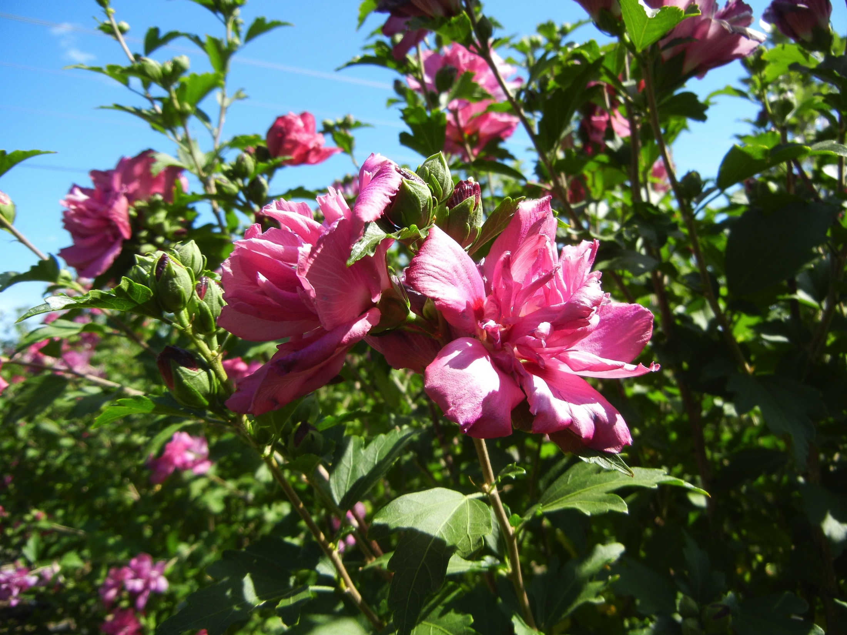
8
Poem on horseback roadside rose of sharon: devoured by my horse
Notes:
PUT POEM ON SCREEN, explain (no kireji, keri)
READ, according to order listed:
INTERPRETERS 105
which leads to BASHO’S JOURNEY 14
which leads to haiga (next slide)
道のべの木槿は馬にくはれけり
michinobe no mukuge wa uma ni kuwarekeri
Autumn / 1684
Kigo: rose of sharon (mukuge)
Note: “The blossoms of the rose of sharon wither after only one day. … [According to legend] Bashō told the Zen Master Butchō, who had disapproved of poetry, that haikai was simply what happens here and now. Butchō pointed to the rose of sharon and asked for a hokku, and Bashō composed this verse.” [Barnhill]

Slide 18
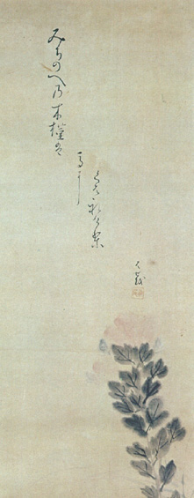
Poem on horseback roadside rose of sharon: devoured by my horse
Painting, calligraphy, poem by Bashō
Notes:
Note “linking” — the poem is about the relationship of the rose of sharon to the horse, but we see only the flower
You could say that the open space is death
Or the open space is what embraces the beauty of the flower, soon to be gone
道のべの木槿は馬にくはれけり
michinobe no mukuge wa uma ni kuwarekeri
Autumn / 1684
Kigo: rose of sharon (mukuge)
Note: “The blossoms of the rose of sharon wither after only one day. … [According to legend] Bashō told the Zen Master Butchō, who had disapproved of poetry, that haikai was simply what happens here and now. Butchō pointed to the rose of sharon and asked for a hokku, and Bashō composed this verse.” [Barnhill]
Image from: http://taka.no.coocan.jp/a5/cgi-bin/dfrontpage/kaigatohaiku/basyounado1.htm (http://taka.no.coocan.jp/a5/cgi-bin/dfrontpage/)

Slide 19
Poem on horseback roadside rose of sharon: devoured by my horse
Notes:
For me, although this detail helps me see the flower, it has less impact than with the open space, and the poem that indicates its fate
This is not just an illustration of the topic of the poem
道のべの木槿は馬にくはれけり
michinobe no mukuge wa uma ni kuwarekeri
Autumn / 1684
Kigo: rose of sharon (mukuge)
Note: “The blossoms of the rose of sharon wither after only one day. … [According to legend] Bashō told the Zen Master Butchō, who had disapproved of poetry, that haikai was simply what happens here and now. Butchō pointed to the rose of sharon and asked for a hokku, and Bashō composed this verse.” [Barnhill]
Image from: http://taka.no.coocan.jp/a5/cgi-bin/dfrontpage/kaigatohaiku/basyounado1.htm (http://taka.no.coocan.jp/a5/cgi-bin/dfrontpage/)

Slide 20
Notes:
Note “linking” — the poem is about the relationship of the rose of sharon to the horse, but we see only the flower
You could say that the open space is death
Or the open space is what embraces the beauty of the flower, soon to be gone
道のべの木槿は馬にくはれけり
michinobe no mukuge wa uma ni kuwarekeri
Autumn / 1684
Kigo: rose of sharon (mukuge)
Note: “The blossoms of the rose of sharon wither after only one day. … [According to legend] Bashō told the Zen Master Butchō, who had disapproved of poetry, that haikai was simply what happens here and now. Butchō pointed to the rose of sharon and asked for a hokku, and Bashō composed this verse.” [Barnhill]
Image from: http://taka.no.coocan.jp/a5/cgi-bin/dfrontpage/kaigatohaiku/basyounado1.htm (http://taka.no.coocan.jp/a5/cgi-bin/dfrontpage/)

Slide 21
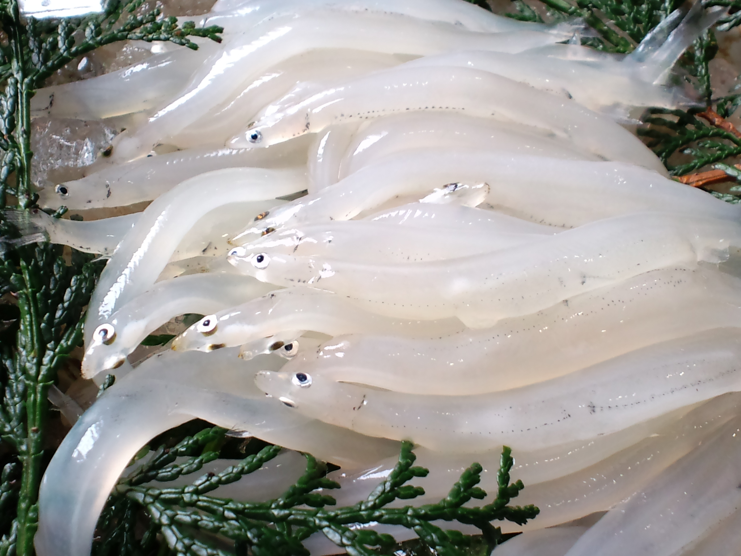
I went out to the beach at daybreak, when it was still dark. twilight of dawn: a whitefish, / with an inch / of whiteness
Notes:
明ぼのやしら魚しろきこと一寸
akebono ya shirauo shiroki koto issun
Winter / 1684–85
Kigo: whitefish (shirauo)
Notes: “This verse alludes to a poem by Du Fu, which has the couplet ‘Each whitefish has its life / by nature one inch.’” [Barnhill]

Slide 22
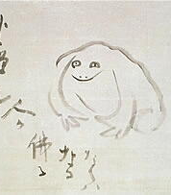
10 old pond a frog jumps in, water’s sound
Haiga by Sengai
Rinzai Zen Monk
1750-1837
Notes:
I would like to skip this poem, except to comment on the tradition of the poem
Sengai Gibon (仙厓 義梵, 1750 - 1837) was a Japanese monk of the Rinzai (臨在宗) school
10
古池や蛙飛びこむ水の音
furuike ya kawazu tobikomu mizu no oto
Spring / 1686
Kigo: frog (kawazu)
Image from: http://www5.atpages.jp/denshouuta/page017.html

Slide 23
11
Tranquil listening
“Come, hear the bagworm’s voice!” simple hut
Notes:
EXPLAIN (kireji, conversational style, greeting poem / social aspect of poetry)
An invitation AND about listening very carefully: 田中 56, 聴閑：閑寂のうちにじっと耳をすませて聞き入ることである
Notice the sound performance: kikinikoy / chichiyo
11
蓑虫の音を聞きに来よ草の庵
minomushi no ne o kiki ni ko yo kusa no io
Autumn / 1687
Kigo: bagworm (minomushi)
Note: “The bagworm actually does not make any sound, but in Sei Shōnagon’s Pillow Book it was said to make a faint plaintive cry of chichiyo chichiyo (“father!” “father!”). [Barnhill]

Slide 24

“Come, hear the bagworm’s voice!” simple hut
Painting, calligraphy and poem by Bashō
Notes:
蓑虫の音を聞きに来よ草の庵
minomushi no ne o kiki ni ko yo kusa no io
Shirane 162: probably done after he began taking lessons from Kyoriku, in the latter half to 1692
Shirane 173: In response to this hokku by Basho, Yamaguchi Sodō (1642-1716), a scholar of Chinese literature and a kanshi poet, wrote the haibun essay “Comment on the Bagworm” (Minomushi no setsu”), which in turn cause Basho to compose “Postscript to ‘Comment on the Bagworm,’” in which he praised the beauty of Sodō’s poetic prose.
…. So a give and take
Image from: hapstancedepart.files.wordpress.com/2011/01/banana-tree-and-gate-to-the-banana-tree-hut-matsuo-basho-1644-16982.jpg

Slide 25
“Come, hear the bagworm’s voice!” simple hut
Notes:
Lifestyle
蓑虫の音を聞きに来よ草の庵
minomushi no ne o kiki ni ko yo kusa no io
Shirane 162: probably done after he began taking lessons from Kyoriku, in the latter half to 1692
Shirane 173: In response to this hokku by Basho, Yamaguchi Sodō (1642-1716), a scholar of Chinese literature and a kanshi poet, wrote the haibun essay “Comment on the Bagworm” (Minomushi no setsu”), which in turn cause Basho to compose “Postscript to ‘Comment on the Bagworm,’” in which he praised the beauty of Sodō’s poetic prose.
…. So a give and take
Image from: hapstancedepart.files.wordpress.com/2011/01/banana-tree-and-gate-to-the-banana-tree-hut-matsuo-basho-1644-16982.jpg

Slide 26
14 petal upon petal yellow mountain roses fall. waterfall’s rush
Notes:
Linkage between waterfall and petals
Although translated as rapids, that is the notes, not the poem
From interpreters 191: “What interests me is the fact that the poet, while putting something lovely and delicate in the foreground to screen a powerful, violent force of nature, has nevertheless succeeded in giving full expression to that force. — Komiya [Professor of German, 1888-1966]
14
ほろほろと山吹 ちるか瀧の音
horohoro to yamabuki chiru ka taki no oto
Spring / 1688 late 3d Month; late April
Kigo: mountain rose (*yamabuki)
Notes: “Nijikō [the place of the poem], located on the upper reaches of the Yoshino River, is famous for the torrential current that surges through the rocks at that point. The word horohoro is descriptive of thin and delicate things fluttering down one after another, but it can also be used as onomatopoeia for a pheasant’s cry.” [Ueda]
image

Slide 27
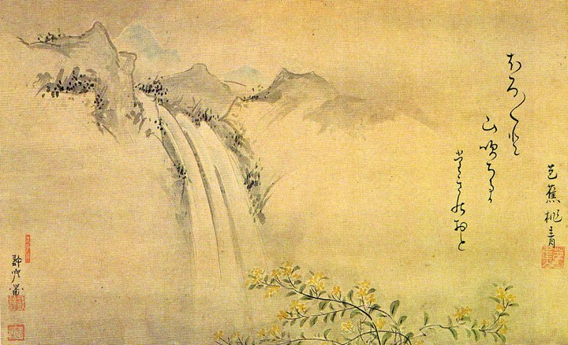
petal upon petal / yellow mountain roses fall. / waterfall’s rush
Painting by Kyoriku, poem and calligraphy by Basho
Notes:
Links
ほろほろと山吹 ちるか瀧の音
horohoro to yamabuki chiru ka taki no oto
Spring / 1688 late 3d Month; late April

Slide 28
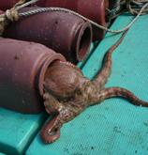
Notes:
Let’s just talk about the pot … Move quickly to next slide
16
蛸壺やはかなき夢を夏の月
takotsubo ya hakanaki yume o natsu no tsuki
Summer / 1688 20th day of 4th month; May 19
Kigo: summer moon (natsu no tsuki)
Notes: An octopus pot is a ceramic trap fisherman use to catch octopi. “Akashi was famous as the place where the Heike warriors were slain. The Japanese poetic tradition emphasized the brevity of summer nights.” [Barnhill]

Slide 29
16 an octopus pot— inside, a short-lived dream under the summer moon
Notes:
16
蛸壺やはかなき夢を夏の月
takotsubo ya hakanaki yume o natsu no tsuki
Summer / 1688 20th day of 4th month; May 19
Kigo: summer moon (natsu no tsuki)
Notes: An octopus pot is a ceramic trap fisherman use to catch octopi. “Akashi was famous as the place where the Heike warriors were slain. The Japanese poetic tradition emphasized the brevity of summer nights.” [Barnhill]

Slide 30
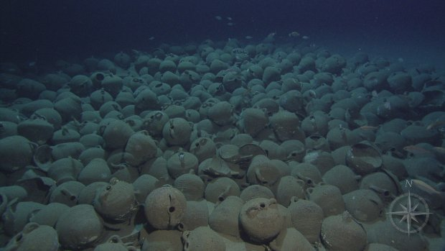
Notes:
Moonlight
16
蛸壺やはかなき夢を夏の月
takotsubo ya hakanaki yume o natsu no tsuki
Summer / 1688 20th day of 4th month; May 19
Kigo: summer moon (natsu no tsuki)
Notes: An octopus pot is a ceramic trap fisherman use to catch octopi. “Akashi was famous as the place where the Heike warriors were slain. The Japanese poetic tradition emphasized the brevity of summer nights.” [Barnhill]
Image from: http://www.nautiluslive.org/photo/2012/09/02/argus-moonlight-view-knidos-f
National Geographic
Argus Moonlight View of Knidos F
It looks as if the moonlight is shining down beautifully on Knidos F, but it's actually the 1200 watt lights from the Argus ROV
- See more at: http://www.nautiluslive.org/photo/2012/09/02/argus-moonlight-view-knidos-f#sthash.FD6lM17U.dpuf

Slide 31
19 red red the sun is pitiless yet the autumn wind
Notes:
EXPLAIN (sound structure, layering, mo)
19
あかあかと日はつれなくも秋の風
akaaka to hi wa tsurenaku mo aki no kaze
Autumn / 1689 17th of 7th Month; August 31
Kigo: autumn wind (akikaze)
Note: “The hokku brings together two seasonal topics: the lingering heat (zanshō) of autumn and autumn’s wind.” [Barnhill]

Slide 32
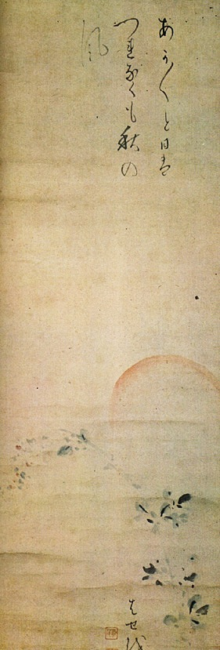
Notes:
Shirane 280: painting, calligraphy, poem by Basho, probably around 1691-92; original poem in Oku 1689 “Here Bashō has drawn the setting sun in light red and the blossoms of the bush clover (hagi), bending slightly in the wind, in light black ink.”
19
あかあかと日はつれなくも秋の風
akaaka to hi wa tsurenaku mo aki no kaze
Autumn / 1689 17th of 7th Month; August 31
Kigo: autumn wind (akikaze)
Note: “The hokku brings together two seasonal topics: the lingering heat (zanshō) of autumn and autumn’s wind.” [Barnhill]

Slide 33
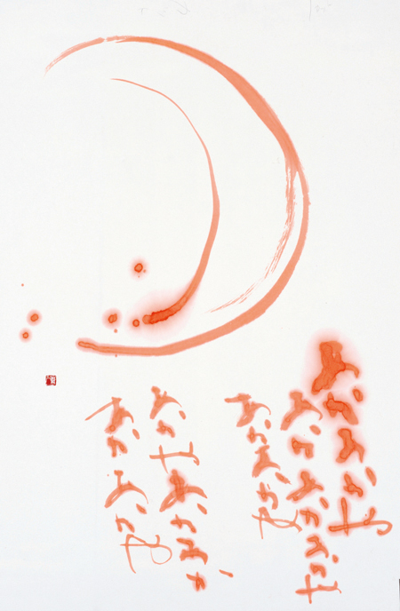
あかあかや
あかあかあかや
あかあかや
あかあかあかや
あかあかや月
Painting and calligraphy by Kakinuma Kōji (calligrapher, b. 1970).
Poem by
Myōe (明恵, 1173-1232,
Kegon monk;
one of the founders of the tea tradition)
Notes:
Image from: http://kaki-bubble.jugem.jp/?eid=598

Slide 34
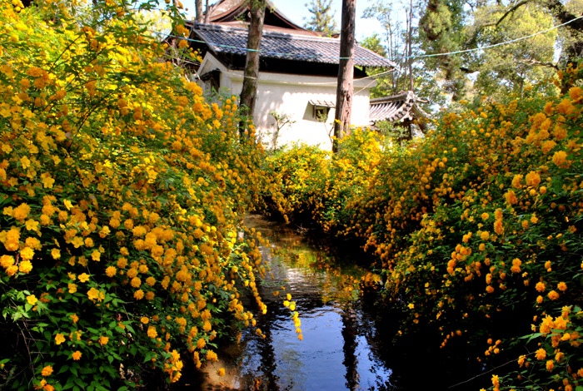
24 mountain roses— when tea ovens at Uji are so fragrant
Notes:
24
山吹や宇治の焙炉の匂ふ時
yamabuki ya Uji no hoiro no niou toki
Spring / 1691
Kigo: mountain rose (*yamabuki)
Uji is near Kyoto and famous for its tea.
image

Slide 35
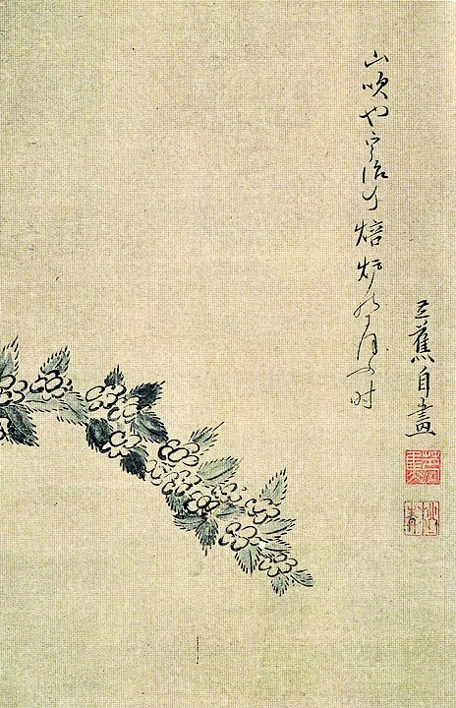
24 mountain roses— when tea ovens at Uji are so fragrant
Notes:
新潮：On a painting; Uji is known for its yamabuki, four stages of tea production: haversting, steaming, roasting, … , brought together the daily life smell with that color
Shirane 118, all by Basho, probably spring 1691
Like the rose of sharon poem, the link is between two things, in this case the flower and the tea fragrance, but, like that haiga, one member of the pair is not represented
24
山吹や宇治の焙炉の匂ふ時
yamabuki ya Uji no hoiro no niou toki
Spring / 1691
Kigo: mountain rose (*yamabuki)
Uji is near Kyoto and famous for its tea.
image

Slide 36
31
A nap.
Feet cool on the wall.
Notes:
The emphasis is on “nap” not “cool” although “cool” is well expressed in the onomatopoeia “hiyahiya to”
31
ひやひやと壁をふまえて昼寝哉
hiyahiya to kabe o fumaete hirune kana
Autumn / 1694 early 7th month; August
Kigo: cool (suzumi)

Slide 37
32
Chrysanthemum fragrance.
In Nara, ancient Buddhas.
Notes:
Chrysanthemum festival day. These ancient Buddhas are not “old Buddhas in Nara now” they are “the Buddhas of the past, when Nara was the capital”. This is a “time slip” poem.
Shirane: 90: “But the poem is better read as a combination poem in which the two parts are joined by scent or connotative equivalences. The chrysanthemum, considered the aristocrat of flowers in classical poetry, possessed a strong but refined fragrance. The many Buddhas in the ancient capital of Nara evoke a similar sense of dignity, solemnity, and refinement as well as a nostalgia for a bygone era.
32
菊の香や奈良には古き仏たち
kiku no ka ya Nara ni wa furuki hotoketachi
Autumn / 1694 9th day of 9th month (Chrysanthemum Festival); Oct 27
Kigo: chrysanthemum (kiku)

Slide 38
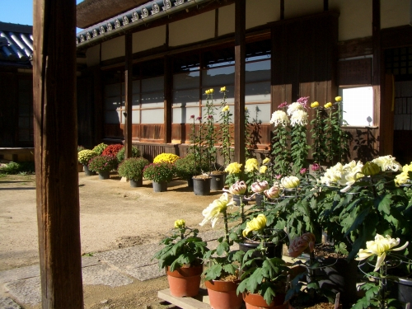
Chrysanthemum decorations at entranceways, Chrysanthemum Festival, 9th Day of 9th Month
Notes:
Kiku are associated with long life
32
菊の香や奈良には古き仏たち
kiku no ka ya Nara ni wa furuki hotoketachi
Autumn / 1694 9th day of 9th month (Chrysanthemum Festival); Oct 27
Kigo: chrysanthemum (kiku)
image

Slide 39
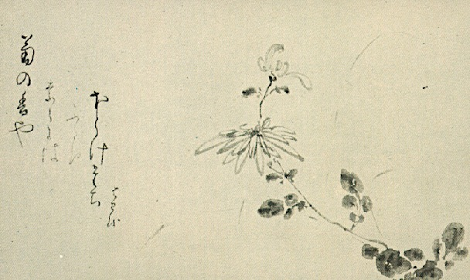
Chrysanthemum fragrance. / In Nara, / ancient Buddhas
Notes:
Again, the linked pair with one not represented, this time a sacred object … but he does seem to be “drawing” fragrance
32
菊の香や奈良には古き仏たち
kiku no ka ya Nara ni wa furuki hotoketachi
Autumn / 1694 9th day of 9th month (Chrysanthemum Festival); Oct 27
Kigo: chrysanthemum (kiku)

Slide 40
verticledetails

Slide 41
verticledetails

Slide 42
Verticledetails verticledetails

