Slide 1
Yosa Buson
Summer, Autumn, Winter

Slide 2
Summer

Slide 3
1
The man and his wife once to be punished by death change into summer clothes
Ueda
Notes:
1
御手討の夫婦なりしを更衣
oteuchi no / myōto narishi o / koromogae
Kigo: 更衣 koromogae “changing clothes [putting away the winter clothes into storage; moving the summer clothes out of storage to regular closets]”
Note: Adultery was punishable by heheading, but these lovers were spared. (Merwin) In the Edo period 'Oteuchi' was the death penalty, mostly being cut to death by the sword, imposed by the Lord of samurai family, when his retainers committed some indiscretion or violated family bans. In former times, the custom of seasonal change of clothing, or koromogae was regularly kept, young and old, high and low. (Terebess Asia Online) Changing the clothes should be seen as a positive-nuance moment and the couple should be viewed as happy, not fearful, or, at least mostly happy. (Wallace)
1—御手討の夫婦なりしを更衣 1, Ueda, shu 232, nakamura 121, tanaka 226
Tanaka 226: を＝のに

Slide 4
Few men can give a quick and apt response to a witticism from a woman, they say. During the reign of the Cloistered Emperor Kameyama some mischievous court ladies made a practice of testing young men who came to court by asking if they had ever heard a nightingale sing. A certain major counselor answered, “An insignificant person the likes of myself could never be so privileged.” The Horikawa minister of the interior said, “I believe I have heard one at Iwakura.” The women said, “That’s a perfectly good answer. The major counselor’s calling himself insignificant was unfortunate.” Such where their evaluations.
Notes:
2
岩くらの狂女恋せよほととぎす
iwakura no / kyōjo koi seyo / hototogisu
Kigo: 子規 hototogisu “lesser Japanese cuckoo”
Note: Crowley’s interpretation is more likely to be the correct one. (Wallace)
2—岩くらの狂女恋せよほととぎす 2 shu 241, Yamamoto 22, 39, ogata 270, suzuki 10, http://yugyofromhere.blog8.fc2.com/blog-entry-2606.html , http://www.geocities.jp/general_sasaki/buson-hptotogisu-ni.html
Shu 241 links this to 徒然草107: Keene translation, Essays in Idleness, 107: “Few men can give a quick and apt response to a witticism from a woman, they say. During the reign of the Cloistered Emperor Kameyama some mischievous court ladies made a practice of testing young men who came to court by asking if they had ever heard a nightingale sing. A certain major counselor answered, “An insignificant person the likes of myself could never be so privileged.” The Horikawa minister of the interior said, “I believe I have heard one at Iwakura.” The women said, “That’s a perfectly good answer. The major counselor’s calling himself insignificant was unfortunate.” Such where their evaluations. … A man should be trained in such a way that no woman will ever laugh at him.” I once heard someone say that it was thanks to the instruction the Jodoji chancellor received as a boy from the Retired Empress Anki that he spoke so ably. The Yamashina minister of the left once said, “I feel embarrassed and nervous even when some wretched serving-girl looks at me.” In a world without women it would not make any difference what kind of clothes or hate a man wore; nobody would take the trouble to dress properly. … One might wonder, then, what exalted creatures women must be to inspire such fear in men. In fact, women are all perverse by nature. They are deeply self-centered, grasping in the extreme, devoid of all susceptibility to reason, quick to indulge in superstitious practices….”

Slide 5
A man should be trained in such a way that no woman will ever laugh at him. I once heard someone say that it was thanks to the instruction the Jodoji chancellor received as a boy from the Retired Empress Anki that he spoke so ably. The Yamashina minister of the left once said, “I feel embarrassed and nervous even when some wretched serving-girl looks at me.” In a world without women it would not make any difference what kind of clothes or hate a man wore; nobody would take the trouble to dress properly.
One might wonder, then, what exalted creatures women must be to inspire such fear in men. In fact, women are all perverse by nature. They are deeply self-centered, grasping in the extreme, devoid of all susceptibility to reason, quick to indulge in superstitious practices. . . .
Notes:
2
岩くらの狂女恋せよほととぎす
iwakura no / kyōjo koi seyo / hototogisu
Kigo: 子規 hototogisu “lesser Japanese cuckoo”
Note: Crowley’s interpretation is more likely to be the correct one. (Wallace)
2—岩くらの狂女恋せよほととぎす 2 shu 241, Yamamoto 22, 39, ogata 270, suzuki 10, http://yugyofromhere.blog8.fc2.com/blog-entry-2606.html , http://www.geocities.jp/general_sasaki/buson-hptotogisu-ni.html
Shu 241 links this to 徒然草107: Keene translation, Essays in Idleness, 107: “Few men can give a quick and apt response to a witticism from a woman, they say. During the reign of the Cloistered Emperor Kameyama some mischievous court ladies made a practice of testing young men who came to court by asking if they had ever heard a nightingale sing. A certain major counselor answered, “An insignificant person the likes of myself could never be so privileged.” The Horikawa minister of the interior said, “I believe I have heard one at Iwakura.” The women said, “That’s a perfectly good answer. The major counselor’s calling himself insignificant was unfortunate.” Such where their evaluations. … A man should be trained in such a way that no woman will ever laugh at him.” I once heard someone say that it was thanks to the instruction the Jodoji chancellor received as a boy from the Retired Empress Anki that he spoke so ably. The Yamashina minister of the left once said, “I feel embarrassed and nervous even when some wretched serving-girl looks at me.” In a world without women it would not make any difference what kind of clothes or hate a man wore; nobody would take the trouble to dress properly. … One might wonder, then, what exalted creatures women must be to inspire such fear in men. In fact, women are all perverse by nature. They are deeply self-centered, grasping in the extreme, devoid of all susceptibility to reason, quick to indulge in superstitious practices….”

Slide 6
2
Cause the madwoman at Iwakura to fall more deeply in love
O hototogisu
Hey, hototogisu!
Go love that perverse Iwakura woman.
Cheryl A. Crowley
Wallace
Notes:
2
岩くらの狂女恋せよほととぎす
iwakura no / kyōjo koi seyo / hototogisu
Kigo: 子規 hototogisu “lesser Japanese cuckoo”
Note: Crowley’s interpretation is more likely to be the correct one. (Wallace)
2—岩くらの狂女恋せよほととぎす 2 shu 241, Yamamoto 22, 39, ogata 270, suzuki 10, http://yugyofromhere.blog8.fc2.com/blog-entry-2606.html , http://www.geocities.jp/general_sasaki/buson-hptotogisu-ni.html
Shu 241 links this to 徒然草107: Keene translation, Essays in Idleness, 107: “Few men can give a quick and apt response to a witticism from a woman, they say. During the reign of the Cloistered Emperor Kameyama some mischievous court ladies made a practice of testing young men who came to court by asking if they had ever heard a nightingale sing. A certain major counselor answered, “An insignificant person the likes of myself could never be so privileged.” The Horikawa minister of the interior said, “I believe I have heard one at Iwakura.” The women said, “That’s a perfectly good answer. The major counselor’s calling himself insignificant was unfortunate.” Such where their evaluations. … A man should be trained in such a way that no woman will ever laugh at him.” I once heard someone say that it was thanks to the instruction the Jodoji chancellor received as a boy from the Retired Empress Anki that he spoke so ably. The Yamashina minister of the left once said, “I feel embarrassed and nervous even when some wretched serving-girl looks at me.” In a world without women it would not make any difference what kind of clothes or hate a man wore; nobody would take the trouble to dress properly. … One might wonder, then, what exalted creatures women must be to inspire such fear in men. In fact, women are all perverse by nature. They are deeply self-centered, grasping in the extreme, devoid of all susceptibility to reason, quick to indulge in superstitious practices….”
「岩くらの 狂女恋せよ ほととぎす」
岩倉は、松園さんの「花筐」の照日の前を描くために通った精神病院のある地。
岩倉・大雲寺の不動堂は狂人たちの治療場として当時から有名だったそうだ。
安永2年（1773）4/4に描かれた。

Slide 7
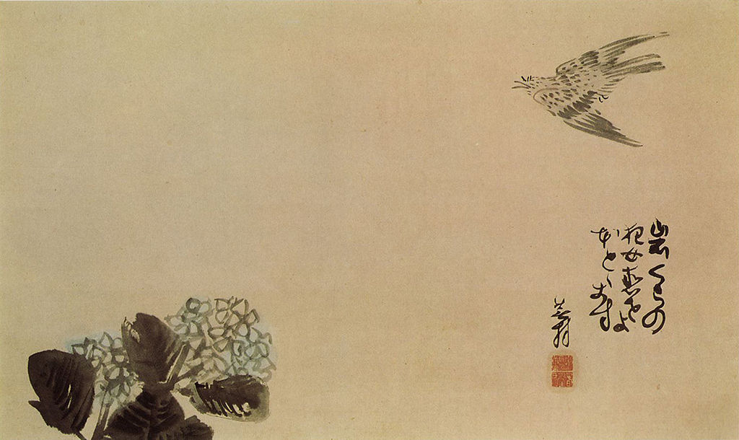
Hey, hototogisu!
Go love that perverse Iwakura woman
Notes:
岩くらの狂女恋せよほととぎす

Slide 8
Hey, hototogisu!
Go love that perverse Iwakura woman
Notes:
岩くらの狂女恋せよほととぎす

Slide 9
Hey, hototogisu!
Go love that perverse Iwakura woman
Notes:
岩くらの狂女恋せよほととぎす

Slide 10
5
All the way I have come all the way I am going here in the summer field
I have walked, walked.
I will walk, walk.
Summer field!
Merwin & Lento
Wallace
Notes:
5 sound
行々てこゝに行々夏野かな
yuki yuki te / koko ni yuki yuku / natsuno kana
Kigo: 夏野 natsu-no “summer field”
5—行々てこゝに行々夏野かな 5 shu 355 sound, nakamura 158, ogata 59
http://eastasiastudent.net/china/classical/%E8%A1%8C%E8%A1%8C%E9%87%8D%E8%A1%8C%E8%A1%8C-marching-on
This is a translation of the poem 行行重行行 from 古詩十九首 (Nineteen Old Poems) [The Gushi shijiu shou 古詩十九首 "Nineteen ancient poems" is a collection of anonymous regular poems from the Han period 漢 (206 BCE-220 CE).]
Marching on and on,
Living far away from you.
We stand more than a thousand miles apart,
Each of us at opposite ends of the sky.
The way between us is long and obstructed,
Who knows if we will see each other again?
The barbarian horses need the winds of the North,
The birds of Yue nest in the branches of the South.
Every day we grow further apart,
Every day my clothes become looser.
The drifting clouds obscure the sunlight,
The wanderer does not consider going back.
Longing for you makes one grow old,
The months and years are suddenly far behind me.
But let’s not speak any more of this rejection;
Please make sure you are eating well.
行行重行行
xíng xíng chóng xíng xíng
[walk] [walk] [again] [walk] [walk]
Marching on and on,
與君生別離
yǔ jūn shēng biélí
[from] [you] [live] [separate] [leave]
Living far away from you.
相去萬餘里
xiāng qù wàn yú lǐ
[each other] [remove] [ten thousand] [excess] [mile]
We stand more than a thousand miles apart,
各在天一涯
gè zài tiān yī yá
[each] [at] [sky] [one] [horizon]
Each of us at opposite ends of the sky.
道路阻且長
dào lù zǔ qiě zhǎng
[way] [road] [obstructed] [and] [long] The way between us is long and obstructed,
會面安可知
huì miàn ān kě zhī
[meet] [face] [secure] [can] [know]
Who knows if we will see each other again?
胡馬依北風
hú mǎ yī běi fēng
[barbarian] [horse] [depend] [north] [wind] The barbarian horses need the winds of the North,
越鳥巢南枝
yuè niǎo cháo nán zhī
[Yue] [bird] [nest] [south] [branch]
The birds of Yue nest in the branches of the South.
相去日已遠
xiāng qù rì yǐ yuǎn
[each other] [remove] [day] [already] [far]
Every day we grow further apart,
衣帶日已緩
yī dài rì yǐ huǎn
[clothes] [belt] [day] [already] [loose]
Every day my clothes become looser.
浮雲蔽白日
fú yún bì bái rì
[drift] [cloud] [conceal] [white] [sun]
The drifting clouds obscure the sunlight,
遊子不顧反
yóu zǐ bù gù fǎn
[wanderer][] [not] [consider] [go back]
The wanderer does not consider going back.
思君令人老
sī jūn lìng rén lǎo
[long for] [you] [make] [person] [old]
Longing for you makes one grow old,
歲月忽已晚
suì yuè hū yǐ wǎn
[year] [month] [suddenly] [already] [late]
The months and years are suddenly far behind me.
棄捐勿復道
qì juān wù fù dào
[reject] [abandon] [do not] [again] [speak]
But let’s not speak any more of this rejection;
努力加餐飯
nǔ lì jiā cān fàn
[exert] [strength] [add] [food] [food]
Please make sure you are eating well.

Slide 11
5
行行重行行 xíng xíng chóng xíng xíng
行行重行行 from 古詩十九首 (Nineteen Old Poems)
Notes:
5 sound
行々てこゝに行々夏野かな
yuki yuki te / koko ni yuki yuku / natsuno kana
Kigo: 夏野 natsu-no “summer field”
5—行々てこゝに行々夏野かな 5 shu 355 sound, nakamura 158, ogata 59
http://eastasiastudent.net/china/classical/%E8%A1%8C%E8%A1%8C%E9%87%8D%E8%A1%8C%E8%A1%8C-marching-on
This is a translation of the poem 行行重行行 from 古詩十九首 (Nineteen Old Poems) [The Gushi shijiu shou 古詩十九首 "Nineteen ancient poems" is a collection of anonymous regular poems from the Han period 漢 (206 BCE-220 CE).]
Marching on and on,
Living far away from you.
We stand more than a thousand miles apart,
Each of us at opposite ends of the sky.
The way between us is long and obstructed,
Who knows if we will see each other again?
The barbarian horses need the winds of the North,
The birds of Yue nest in the branches of the South.
Every day we grow further apart,
Every day my clothes become looser.
The drifting clouds obscure the sunlight,
The wanderer does not consider going back.
Longing for you makes one grow old,
The months and years are suddenly far behind me.
But let’s not speak any more of this rejection;
Please make sure you are eating well.
行行重行行
xíng xíng chóng xíng xíng
[walk] [walk] [again] [walk] [walk]
Marching on and on,
與君生別離
yǔ jūn shēng biélí
[from] [you] [live] [separate] [leave]
Living far away from you.
相去萬餘里
xiāng qù wàn yú lǐ
[each other] [remove] [ten thousand] [excess] [mile]
We stand more than a thousand miles apart,
各在天一涯
gè zài tiān yī yá
[each] [at] [sky] [one] [horizon]
Each of us at opposite ends of the sky.
道路阻且長
dào lù zǔ qiě zhǎng
[way] [road] [obstructed] [and] [long] The way between us is long and obstructed,
會面安可知
huì miàn ān kě zhī
[meet] [face] [secure] [can] [know]
Who knows if we will see each other again?
胡馬依北風
hú mǎ yī běi fēng
[barbarian] [horse] [depend] [north] [wind] The barbarian horses need the winds of the North,
越鳥巢南枝
yuè niǎo cháo nán zhī
[Yue] [bird] [nest] [south] [branch]
The birds of Yue nest in the branches of the South.
相去日已遠
xiāng qù rì yǐ yuǎn
[each other] [remove] [day] [already] [far]
Every day we grow further apart,
衣帶日已緩
yī dài rì yǐ huǎn
[clothes] [belt] [day] [already] [loose]
Every day my clothes become looser.
浮雲蔽白日
fú yún bì bái rì
[drift] [cloud] [conceal] [white] [sun]
The drifting clouds obscure the sunlight,
遊子不顧反
yóu zǐ bù gù fǎn
[wanderer][] [not] [consider] [go back]
The wanderer does not consider going back.
思君令人老
sī jūn lìng rén lǎo
[long for] [you] [make] [person] [old]
Longing for you makes one grow old,
歲月忽已晚
suì yuè hū yǐ wǎn
[year] [month] [suddenly] [already] [late]
The months and years are suddenly far behind me.
棄捐勿復道
qì juān wù fù dào
[reject] [abandon] [do not] [again] [speak]
But let’s not speak any more of this rejection;
努力加餐飯
nǔ lì jiā cān fàn
[exert] [strength] [add] [food] [food]
Please make sure you are eating well.

Slide 12
6
An Idle Student by the Window
Whatever he learns goes in one ear and out the other a firefly scholarly brilliance issues forth from your bottom firefly
Merwin & Lento
Cheryl A. Crowley
Notes:
6
学問は尻からぬけるほたる哉
gakumon wa / shiri kara nukeru / hotaru kana
Kigo: 蛍 hotaru “firefly”
Note: The set phrase is shiri kara nukeru "from the bum" and does indeed mean something close to "in one ear and out the other”. Fireflies, of course, have "bums" that light up. That is part of the joke. We should imagine as well, that there are fireflies just outside the window and the poet, rather than studying, is staring at them, composing this poem. (Wallace)
6—学問は尻からぬけるほたる哉 6 shu 360, Crowley, large 86, http://www.buson-an.co.jp/roman/16.html, http://poyoland.jugem.jp/?eid=246

Slide 13
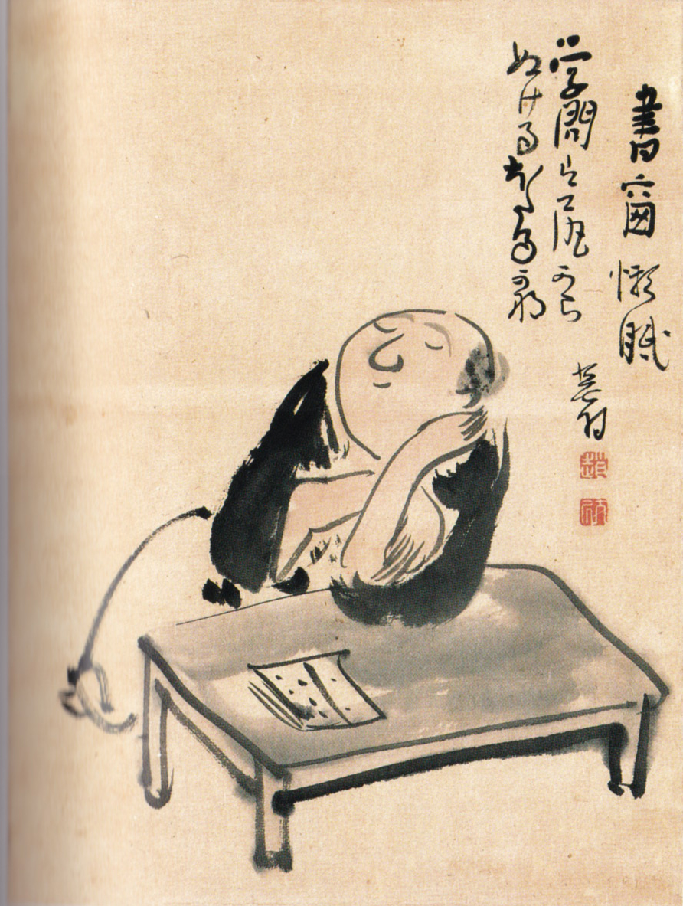
scholarly brilliance issues forth from your bottom firefly
Calligraphy and painting by Buson

Slide 14
8
Cicada chorus time for the head priest to take his bath the cicada are singing— abbot's bath time
Merwin & Lento
Wallace
Notes:
8
せみ啼や僧正房のゆあみ時
semi naku ya / sōjōbō no / yuami doki
Kigo: 蝉 semi “cicada”
8—せみ啼や僧正房のゆあみ時 8 shu 411, suzuki 16, tombo 76
Shu 411: Buson wrote in the margins "I feel I caught something of what cicadas are like with this poem"
The old priest has wakened from his afternoon nap. It is beginning to grow into evening, the cicadas are singing at this time."
Suzuki 16: Tengu. Drawn quickly and crisply. The sound of the evening cicadas plus feeling sticky and sweaty.
Tombo 76: The priest at Kuramayama was called the Tengu Priest.

Slide 15
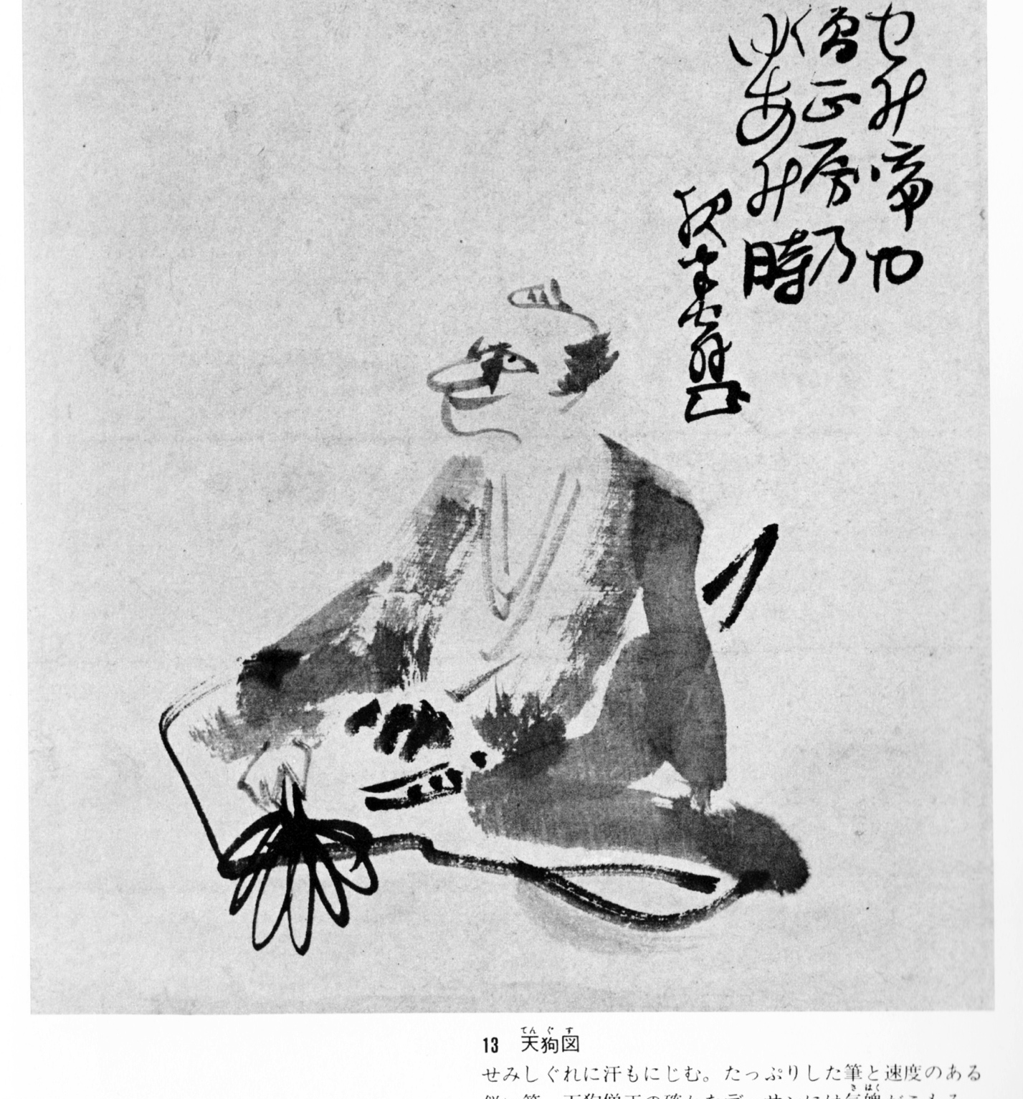
Cicada chorus time for the head priest to take his bath
Calligraphy and painting by Buson
Notes:
8
せみ啼や僧正房のゆあみ時
semi naku ya / sōjōbō no / yuami doki
Kigo: 蝉 semi “cicada”
8—せみ啼や僧正房のゆあみ時 8 shu 411, suzuki 16, tombo 76
Shu 411: Buson wrote in the margins "I feel I caught something of what cicadas are like with this poem"
The old priest has wakened from his afternoon nap. It is beginning to grow into evening, the cicadas are singing at this time."
Suzuki 16: Tengu. Drawn quickly and crisply. The sound of the evening cicadas plus feeling sticky and sweaty.
Tombo 76: The priest at Kuramayama was called the Tengu Priest.

Slide 16
9 summer shower— clutching the leaves of grass a flock of sparrows
Ueda
Notes:
9
夕だちや草葉をつかむむら雀
yūdachi ya / kusaha o tsukamu / mura-suzume
Kigo: 夕立 yūdachi “[summertime] late afternoon thunderstorm”
9—夕だちや草葉をつかむむら雀9 Ueda, shu, nakamura 195, Yamamoto *99

Slide 17
10
Don’t wake me from
This intoxicating dream
On this intoxicated night.
”Welcome luck! (Go away demons!)”
YOI-YUME NO YOI-NE SAMASUNA.
FUKU HA UCHI!
Wallace
Notes:
10 sound (repetition)
よい夢のよひ寝さますな副ハうち
yoiyume no / yoi nesamasu na / fuku wa uchi
Kigo: This is tricky because of the playful nature of the poem. It is a summer poem. And bats are a summer kigo. Bats are usually pronounced kōmori. However, it can also be written: 蝠. This is similar to, and pronounced the same as 福, fuku, “good luck / wealth”. On the last day of winter, Japanese go around the house tossing soy beans out of the house and placing them at key locations in the house, saying “Fuku wa uchi! Oni wa soto!” (“In with good luck, out with demons”). This poem plays with that idea, and so, in a sense, the season should be end of winter but there is no kigo “fuku”. The word play is to take fuku wa uchi to mean “There are bats in my house!”
10—よい夢のよひ寝さますな副ハうち 10 sound, large 99

Slide 18
10
Don’t wake me from
This intoxicating dream
On this intoxicated night.
"Help! There are bats in the house!"
YOI-YUME NO YOI-NE SAMASUNA.
FUKU HA UCHI!
Wallace
Notes:
10 sound (repetition)
よい夢のよひ寝さますな副ハうち
yoiyume no / yoi nesamasu na / fuku wa uchi
Kigo: This is tricky because of the playful nature of the poem. It is a summer poem. And bats are a summer kigo. Bats are usually pronounced kōmori. However, it can also be written: 蝠. This is similar to, and pronounced the same as 福, fuku, “good luck / wealth”. On the last day of winter, Japanese go around the house tossing soy beans out of the house and placing them at key locations in the house, saying “Fuku wa uchi! Oni wa soto!” (“In with good luck, out with demons”). This poem plays with that idea, and so, in a sense, the season should be end of winter but there is no kigo “fuku”. The word play is to take fuku wa uchi to mean “There are bats in my house!”
10—よい夢のよひ寝さますな副ハうち 10 sound, large 99

Slide 19
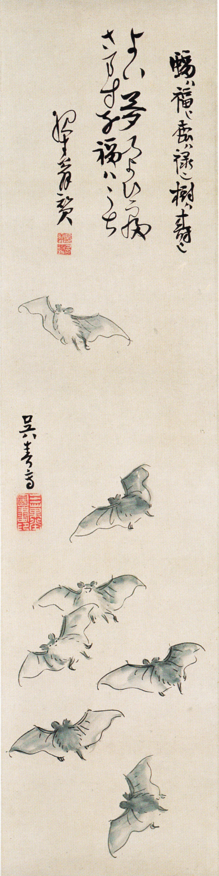
Don’t wake me from
This intoxicating dream
On this intoxicated night.
”Welcome luck! (Go away demons!)”
Calligraphy and painting by Buson

Slide 20
Don’t wake me from
This intoxicating dream
On this intoxicated night.
”Welcome luck! (Go away demons!)”
Calligraphy and painting by Buson

Slide 21
Autumn

Slide 22
12 at a flash of lightning, the sound of dew falling from a bamboo
Ueda
Notes:
12
稲妻にこぼるゝ音や竹の露
inazuma ni / koboruru oto ya / take no tsuyu
Kigo: 稲妻inazuma “lightning”
12—稲妻にこぼるゝ音や竹の露 12 Ueda, shu
Nature connections (Basho-style)

Slide 23
12 at a flash of lightning, the sound of dew falling from a bamboo
petal after petal
mountain roses flutter down:
the sound of the rapids
(Basho)
Ueda
Notes:
12
稲妻にこぼるゝ音や竹の露
inazuma ni / koboruru oto ya / take no tsuyu
Kigo: 稲妻inazuma “lightning”
12—稲妻にこぼるゝ音や竹の露 12 Ueda, shu
Nature connections (Basho-style)

Slide 24
13 over the sumo match he should never have lost a pillow talk
Ueda
Notes:
13
負けましき角力を寝ものがたり
makumajiki / sumai o nemono- / gatari kana
Kigo: 相撲の節 sumai no sechi “[autumn] sumo match”
13—負けましき角力を寝ものがたり 13 Ueda, shu 483, nakamura 222, Yamamoto *113, ogata 146, 277, suzuki 9, tonbo 77
"good faces"

Slide 25
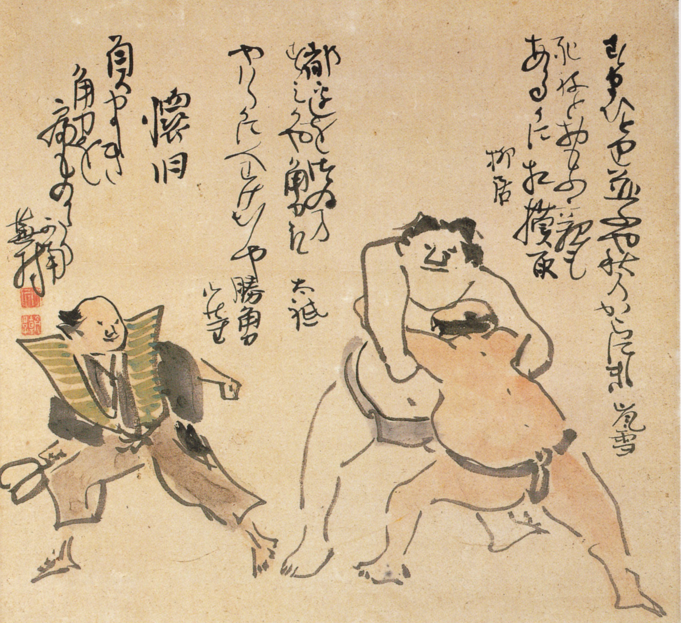
over the sumo match he should never have lost a pillow talk
Calligraphy and painting by Buson
Notes:
負けましき角力を寝ものがたり

Slide 26
over the sumo match he should never have lost a pillow talk
Calligraphy and painting by Buson
Notes:
負けましき角力を寝ものがたり

Slide 27
Notes:
負けましき角力を寝ものがたり

Slide 28
14 the willow is bare the clear stream has dried, and stones lie scattered here and there
Ueda
Notes:
14
柳散清水涸石処々
yanagi chiri / shimizu kare ishi / tokorodoko
Kigo: 柳散る yanagi chiru “willows-fallen [bare willow trees because the leaves have fallen]”
Note: Yūgyō Willow: Named after a Noh play of this title in which the learned priest Yūgyō encounters the spirit of a willow tree. (Merwin) Except that Yūgyō means Saigyō. This poem is in honor of him, who wrote at this spot:
alongside the road
a stream of clear water
shaded by a willow—
wanting to take a rest
I stopped—and I am still here
michinobe ni / shimizu nagaruru / yanagikage / shibashi to te koso / tachidomaritsure
... a spot that Bashō then visits in Narrow Road to the Deep North and writes:
over an entire field
they have planted rice—before
I part with the willow
ta ichimai / uete tachisaru / yanagi kana
That is how Bashō spent time with the long dead Saigyō. Now, Buson visits the spot and writes his haiku.
I find this interesting: is Buson suggestion that the good days of haiku has dried up? Here are links to the willow which, it is claimed, still stands. The second one has clearly been Photoshopped to make it a bit more grand than it really is. http://www.bashouan.com/pbYugyouyanagi.htm http://www2.ucatv.ne.jp/~jata-45.snow/image101.jpg (Wallace)
14—柳散清水涸石処々 14 Ueda, shu, nakamura 249, Yamamoto *108, ogata 123, tanaka 235

Slide 29
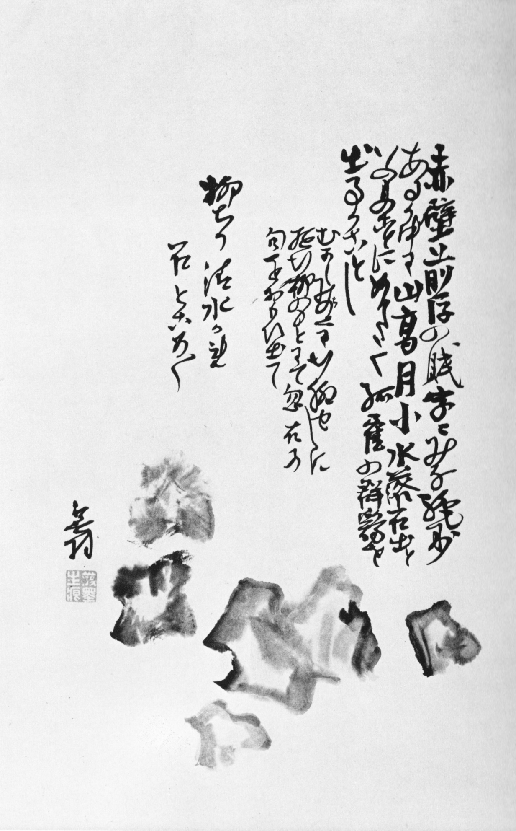
the willow is bare the clear stream has dried, and stones lie scattered here and there
Calligraphy and painting by Buson

Slide 30
15 this piercing cold— in the bedroom, I have stepped on my dead wife’s comb
Ueda
Notes:
15
身にしむや亡妻の櫛を閨に踏
mi ni shimu ya / naki tsuma no kushi o / neya ni fumu
Kigo: 身に入む mi ni shimu “to soak into the body, to penetrate the body, to feel keenly or sharply”
Note: The comb should be seen as a very intimate item once used by his wife. The Japanese feel that objects touched by hand over a long time by a certain person has something of that person in it. (Wallace)
15—身にしむや亡妻の櫛を閨に踏 15 Ueda, shu, nakamura 229, ogata 189

Slide 31
16
With age even the voice of the cricket is sad
Wallace
Notes:
16
としよればこえもかなしききりぎりす
toshi yoreba / koe mo kanashiki / kirigirisu
Kigo: きりぎりす kirigirisu “cricket” (early autumn
16—としよればこえもかなしききりぎりす 16 Addiss

Slide 32
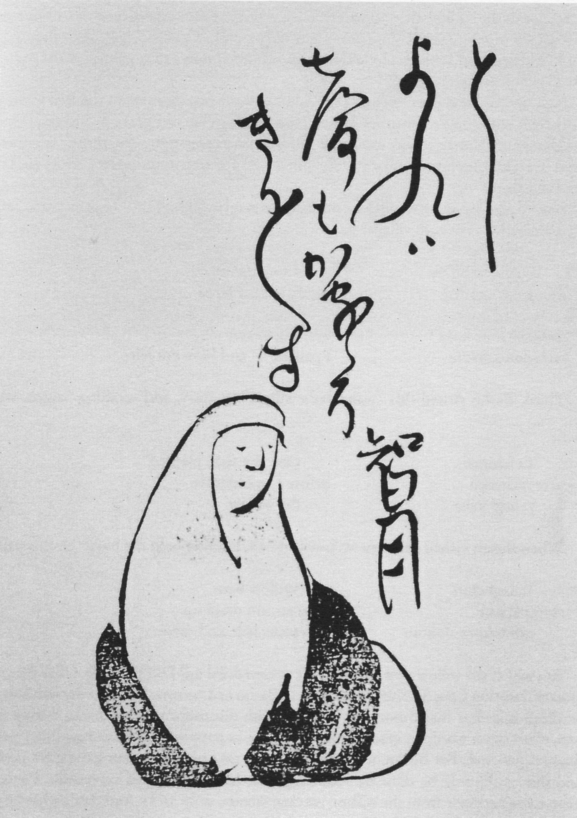
With age
Even the voice of the cricket
Is sad
Calligraphy and painting by Buson
Notes:
としよればこえもかなしききりぎりす
Panels of the 36 famous poets (some version shave two panels, one with the poem, one with the poet)
智月尼（ちげつに）
［?～1708ころ］江戸前期の俳人。山城の人。大津の川井佐左衛門の妻。夫に死別後、尼になる。息子の乙州(おとくに)とともに蕉門に学んだ。
So, こえ＝うた

Slide 33
18
Upon Maruyama’s Request for a Caption to His Painting of a Black Dog
His bark comes from the darkness inside him deep in the autumn night
Merwin & Lento
Notes:
18
おのが身の闇より吼て夜半の秋
ono ga mi no / yami yori hoete / yowa no aki
Kigo: 夜半の秋 yowa no aki “autumn evening”
Note: Once the painter, Maruyama Okyo (1733-1795), drew the figure of a black dog and asked Buson to write an inscription to go with it. (Terebess Asia Online)
18—おのが身の闇より吼て夜半の秋 18 shu 603, large 98

Slide 34
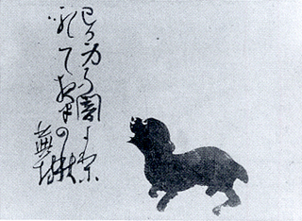
His bark comes from the darkness inside him deep in the autumn night
Calligraphy by Buson, painting by Maruyama
Notes:
おのが身の闇より吼て夜半の秋
Wiki: Maruyama Ōkyo (円山 応挙, traditional characters: 圓山 應舉?, June 12, 1733 – August 31, 1795), born Maruyama Masataka, was a Japanese artist active in the late 18th century. He moved to Kyoto, during which he studied artworks from Chinese, Japanese and Western sources. A personal style of Western naturalism mixed with Eastern decorative design emerged, and Ōkyo founded the Maruyama school of painting. Although many of his fellow artists criticized his work as too slavishly devoted to natural representation, it proved a success with laymen.

Slide 35
His bark comes from the darkness deep in the autumn night
Calligraphy by Buson, painting by Maruyama
Notes:
I prefer to drop the "inside him" —おのが身の中の闇 maybe, but also おのが身が（闇の中にて）吠える 集：まるでおのが身は闇黒の中に隠れて見えぬつもりで吠える
おのが身の闇より吼て夜半の秋
Wiki: Maruyama Ōkyo (円山 応挙, traditional characters: 圓山 應舉?, June 12, 1733 – August 31, 1795), born Maruyama Masataka, was a Japanese artist active in the late 18th century. He moved to Kyoto, during which he studied artworks from Chinese, Japanese and Western sources. A personal style of Western naturalism mixed with Eastern decorative design emerged, and Ōkyo founded the Maruyama school of painting. Although many of his fellow artists criticized his work as too slavishly devoted to natural representation, it proved a success with laymen.

Slide 36
21
Secluded house—
The lord of this chrysanthemum:
Fox Spirit Hakuzōsu
Wallace
Notes:
21
かくれ家や菊のあるじハ白蔵主
kakure-ka ya / kiku no aruji wa Hakuzōsu
Kigo: 菊 kiku “chrysanthemum”
Note: Hakuzōsu is a type of fox spirit. Here is an example: http://metmuseum.org/collections/search-the-collections/49821 . (Wallace)
21—かくれ家や菊のあるじハ白蔵主 21, large 90, http://www.delicasuito.co.jp/mc0610.html

Slide 37
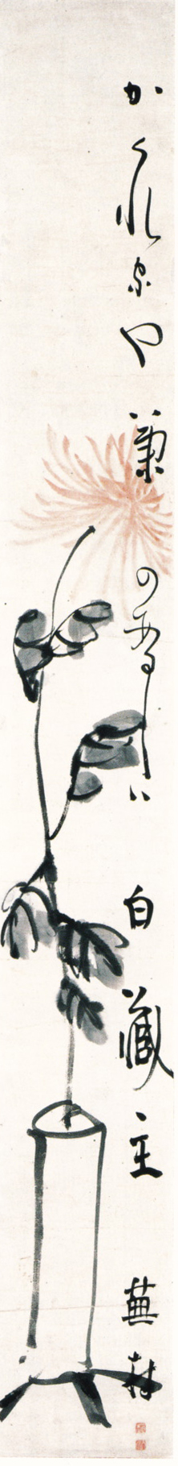
Secluded house—
The lord of this chrysanthemum:
Fox Spirit Hakuzōsu
Calligraphy and painting by Buson
Notes:
21
かくれ家や菊のあるじハ白蔵主
kakure-ka ya / kiku no aruji wa Hakuzōsu
Kigo: 菊 kiku “chrysanthemum”
Note: Hakuzōsu is a type of fox spirit. Here is an example: http://metmuseum.org/collections/search-the-collections/49821 . (Wallace)
21—かくれ家や菊のあるじハ白蔵主 21, large 90, http://www.delicasuito.co.jp/mc0610.html relationship of 字／絵 is interesting

Slide 38
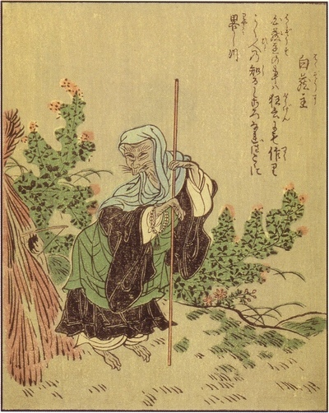

Slide 39
Winter

Slide 40
29
You who pray to Buddha beating your gourds you are nobody at all not even village priests
Merwin & Lento
Notes:
29
木の端に坊主のはしや鉢たたき
ki no hashi no / bōzu no hashi ya / hachi-tataki
Kigo: 鉢叩 hachi-tataki “drumming-the-gourd”
Note: "From the 13th of November until the 31 of December, the priests and lay people of the Kuya Hall walk the streets of Kyoto, hitting the gongs and dancing.” (http://darumapilgrim.blogspot.com/2005/09/kuya-shonin.html this is a great Web site for all things Kuya, one of the early founders of Pure Land Buddhism in Japan) (Wallace)
29—木の端に坊主のはしや鉢たたき 29 shu 815, large 89
The practioners of this were はん‐ぞく【半俗】なかば俗人のような風体、または生活をしている僧。「半僧―」

Slide 41
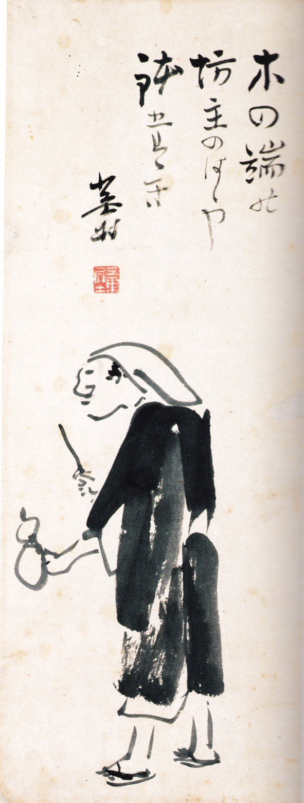
You who pray to Buddha beating your gourds you are nobody at all not even village priests
Calligraphy and painting by Buson
Notes:
木の端に坊主のはしや鉢たたき

Slide 42
You who pray to Buddha beating your gourds you are nobody at all not even village priests
Calligraphy and painting by Buson
Notes:
木の端に坊主のはしや鉢たたき

Slide 43
33
In the night with my few teeth
I try to chew the ice off the tip of my writing brush baring my teeth
I moisten my frozen writing brush
—that sort of night
Merwin & Lento
Wallace
Notes:
歯あらはに筆の氷を噛ム夜哉
ha arawa ni / fude no kōri o / kamu yo kana
Kigo: 氷kōri “ice”
歯あらはに筆の氷を噛ム夜哉 33 shu 832, nakamura 286, ogata 294, shincho 1, http://ameblo.jp/gaju-kuma/entry-10897561590.html
poverty

Slide 44
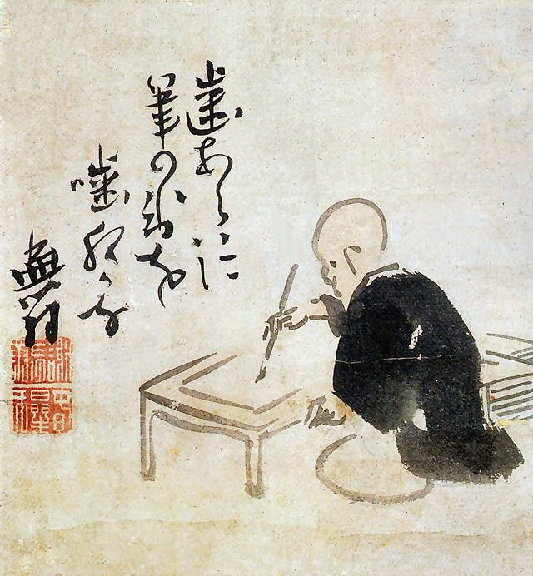
In the night with my few teeth
I try to chew the ice off the tip of my writing brush
Calligraphy and painting by Buson

